Slide 1
Vocational Discernment and Action: Building Mentoring Communities for Students, Faculty, and Staff through International Retreats and Faith Conversation
NetVUE - St. Louis
March 28, 2015
Sara Barton - University Chaplain
Jay Brewster - Associate Provost
Cindy Miller-Perrin - Distinguished Professor of Psychology
Gary Selby - Professor of Communication and Director, Center for Faith and Learning
Don Thompson - Professor of Great Books & Mathematics
Pepperdine University - Malibu

Slide 2

Lilly Endowment Inc. is an Indianapolis-based, private philanthropic foundation created in 1937 by three members of the Lilly family -- J.K. Lilly Sr. and sons J.K. Jr. and Eli -- through gifts of stock in their pharmaceutical business, Eli Lilly and Company.
Program for the Theological Exploration of Vocation
2002-07
Pepperdine requests funding for proposal entitled “The Pepperdine Voyage: Nurturing Lives of Purpose, Service, and Leadership.”
$2M funding provided for 5 years
2008-11
$500K supplemental grant extends funding 3 years
2008-11
The Pepperdine Voyage continues…
  New faculty retreat
  Student Conversations regarding faith
  Student Ministry Initiatives

Slide 3
The project includes the following five areas of emphasis.
A CURRICULAR COMPONENT that challenges undergraduate students to reflect on and live out their calling throughout their four years.
A CO-CURRICULAR COMPONENT that intersects with the academic component challenging students to commit themselves in three specific areas: service, leadership, and Christian ministry.
A FACULTY/STAFF DEVELOPMENT COMPONENT that is grounded in the conviction, strongly affirmed by the Lilly Endowment, that all participants— faculty in particular—must be encouraged to think theologically about vocation. If we fail to do this, then we can hardly expect students to be able to explore vocation from a theological perspective.
A MINISTRY COMPONENT that encourages all students, regardless of their majors or career plans:
a) to think of their future careers in terms of Christian ministry, b) to consider formal, church-based ministry as a vocation, and (c) allowing those students preparing for a vocation in the context of the church to broaden their vocational horizons through a meaningful internship program.
A COMPONENT FOR THE FOUR PROFESSIONAL SCHOOLS that challenges students to envision their entire lives as vocation.

Slide 4

The Pepperdine Voyage: Curriculum and Co-curriculum
First Year Program:
Integration of vocation dialogue into
academic content
Peer leaders for first year seminars
Point of Entry opportunities for service
Continuing the Voyage:
Internship Program for Religion students
Annual Women in Ministry Conference
Leadership through service program
Spiritual Life Advisors located in student
housing community
Service components in International Programs

Slide 5
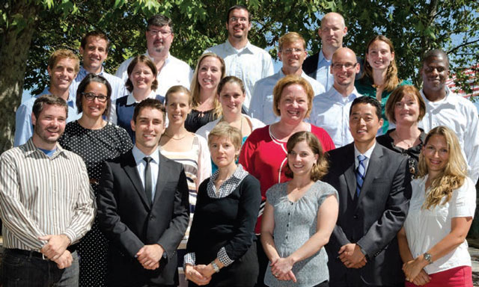
The Pepperdine Voyage: Faculty Development
Funding for Curriculum Development
- Addressing faith and vocation within specific academic disciplines
Seminars: “Faith, Learning and Vocation”
- vocation of the Christian university
- vocation of the Christian scholar/teacher
New Faculty Retreat
one week program at an international program site
full opportunity for reading, discussion, engagement of vocational content

Slide 6

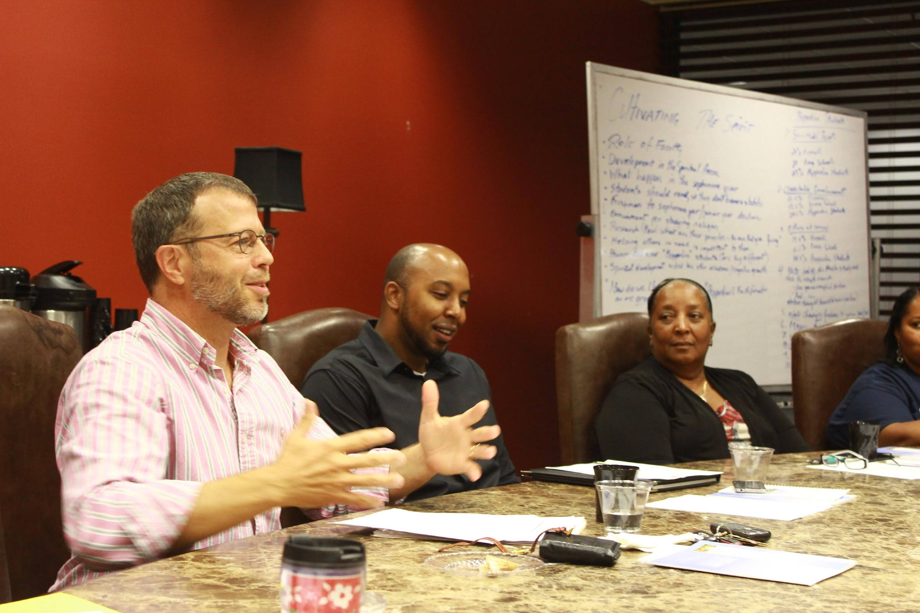
Pepperdine University Center for Faith and Learning
Annual New Faculty Retreat
Annual Mid-Career Retreat

Slide 7
Pepperdine University Center for Faith and Learning
Annual New Faculty Retreat
OVERVIEW
Rationale:
  Faculty as the “Front Line” for Encouraging Students’ Sense of Vocation and Mission
  Desire to broaden faculty’s sense of mission beyond that of advancing scholarship in their discipline
Format: 7-10 Day Intensive Seminar on Faith, Learning, and Vocation
Location: Pepperdine Study Abroad Facility (Florence, Buenos Aires, Lausanne)

Slide 8
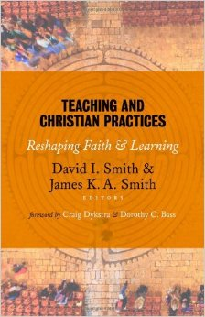


Pepperdine University Center for Faith and Learning
Annual New Faculty Retreat
COMPONENTS
Daily Worship
Sessions 1-2: Vocational Stories
Sessions 3-4: Scholars and Teachers
Session 5: What Makes a University Christian?

Slide 9

Pepperdine University Center for Faith and Learning
Mid-Career Retreat
COMPONENTS
Daily Worship
Sessions 1-2: Vocational Stories
Sessions 3-4: Faith and Learning, Teaching and Writing in the Second Half of Life
Session 5: Falling Upward

Slide 10
Pepperdine University Center for Faith and Learning
Annual New Faculty Retreat
FEEDBACK
The retreat fostered community among new professors.
The best part was sharing vocational stories. [This] connects well to Palmer’s thoughts on being real and vulnerable with our students to be good teachers.
The impact was tremendous. It provided a rare opportunity to explore personal vocation and the mission of the university . . . It called on us to . . . reflect on our faith in and through our teaching.
Sharing vocational stories . . . helped remind us of the circuitous routes we all took, the roadblocks and the hardships, which I think is very grounding for us and reminds of the challenges and fears of our students.
[The retreat was] life changing, and there aren’t many experiences I’ve had in my life that I would say that about.

Slide 11
Research Design & Findings
Faculty Surveys (2007-Present)
Hypothesis: New faculty enter with an incomplete sense of calling and institutional role; Time and workshop participation increase depth of understanding and institutional commitment
Survey Components & Implementation
  Vocational Definition & Discernment
  Faculty Calling Sense & Barriers
  Institutional Identity, Mission, & Contribution
  Fall, Spring, Summer Survey Cycle
  Pre-Post Analysis relative to Faculty Retreat

Slide 12
Vocational Calling Definition
Pre - Primary focus on “job” and “career”
I believe that vocational calling is the job to which one feels drawn
A strong, almost irresistible calling to a line of work
An academic scholar who uses their gifts to give back to the world through teaching and applied research
Post - Service to others, using passions/gifts/talents, directive from God
Promptings provided by others (peers, mentors) and God for a direction to a way of life
A personal mission to find meaning in life and to share ways of understanding the mission that God has set down for each and every one of us here on earth. Likewise, we are to prepare ourselves and others to leave life knowing that we have endeavored to do God's work and to make the world a better place.
A personal journey orchestrated by "God" to prepare for and fulfill a professional purpose
The area in which I serve professionally that integrates my call to Christ and the ways in which God has uniquely created me

Slide 13
Vocational Calling Discernment
Pre - Conversation with friends & mentors, experimenting with various jobs
Experiment with a variety of jobs and trades and seek counsel from wise people who you trust.
Ask three to five individuals that know you, but not each other
Make a decision and then do it with all your might
I listen to my students and peer feedback and continually try to improve on my vocation
Post - Discovering a greater sense of meaning, passion, joy, competence
By His guidance and observing in what areas I have abilities, am passionate, and thrive, and contribute to the lives of others and to the community in which I live.
A lifelong process, honed and refined through significant experiences, defining conversations, and much prayer.
Listening intently to what my heart and prayer life tell me are the most fulfilling, joyful, peaceful, and loving parts of my day, the activities that provide me with the deepest forms of satisfaction.
That which gives me a sense of purpose and meaning.

Slide 14
My Role as a member of the Pepperdine Faculty
Pre - Teacher, researcher, provide excellent training, community Member
Provide students with excellent training in my area of expertise and to help them achieve their goals (both spiritual and temporal) by providing encouragement, advice, friendship, and assistance to the best of my ability
I am called to be a teacher and a scholar. As a scholar I endeavor to discover the truths of my particular discipline within a community of wider researchers and academics. As a teacher my job is to share the fruits of my knowledge, encourage, and instruct students in what it means to be both an inquirer into truth and a cooperative, charitable member of community
Post - Strengthening Christian ethics and virtues in student, help them make a difference in the world
To be an educator of the whole person, igniting students’ intellectual curiosity and ability to think critically, supporting their personal development and vocational clarity, and nurturing a love for God and a desire to honor Him
As a scholar I am called to be a servant of truth. As a teacher I am called to be a servant of the educational process of my students

Slide 15
Barriers to Living Out My Calling
Pre - Limited experience, tight finances, balancing demands, none
There aren’t any; I don't believe there are any significant barriers at this time
Perceived lack of time for thinking, reflection, and reading
Finances, worldly worries, balancing many demands
It is difficult to find enough hours in the day
Post - Fear of failure, anxiety, lack of discipline, pressure to conform, lack of job security
Me. The demonic voices of self doubt, feelings of insecurity, and paralyzing fear of failure often choke out my joy of serving at a place like Pepperdine. I have to remind myself daily that “God is in charge” and that He has always provided for me and always will.
Intense pressure to be all things to all people, especially in my work life. The specter of tenure haunts, but only occasionally.
Lacking a sense of job security prevents me from living out my calling and from investing fully in the Pepperdine community.
This retreat has helped solidify our relationship to the University and to our colleagues. Perhaps the lack of conversation and community around these issues is also a barrier.

Slide 16
Understanding the Mission of Pepperdine University
Pre - Fulfill the goals of purpose, service, and leadership, foster spiritual growth
To educate students and enable them to serve.
To pursue the very highest academic standards and to support its students in the lifelong pursuit of purpose, leadership and service.
It is the primary motor behind the intellectual drive of the university. There is no contradiction between deep faith and the pursuit of either academic or spiritual truth.
Post - Integration of scholarship, teaching, and faith, academic excellence, strengthening faith, build sense of community, acceptance of non-religious
The gift of education, which we should never take for granted, does call us to a life of purpose, service, and leadership. I am completely on board with this mission. To my mind it does not exclude non-Christians.
Pepperdine University seeks to maintain very high standards of academic excellence and Christian values. An important part of this mission involves shaping students for lives of purpose that further God's kingdom. This requires serving others, as well as serving as leaders in the community

Slide 17
Office of the Chaplain
Conversations that engage students, faculty, and staff
in faith and vocation dialogue
Partnership Examples
How we are deepening conversations about spirituality - Cruciform Spirituality (How the Cross Shapes Faith Journey)
When Learning Rocks Your Faith - Finding Heroes and Mentors for the Journey
Faculty Leadership
Dr. Ryan Board, Pepperdine Chamber Choir – Prayer and Contemplation of Lenten Musical Composition of the Baroque Era
Dr. Rob Shearer, Surf Chapel – How a business professor’s passion for surfing is building community and faith outside the classroom
Dr. Ron Highfield - discussion of his recent book, Exploring God, Freedom and Human Dignity: Embracing a God-Centered Identity in a Me-Centered Culture.

Slide 18
Lessons Learned
Faculty Development
Student Dialogue
Discipleship in Practice
Institutional Culture Transformed
Community Enrichment
Follow Up:
thompson@pepperdine.edu

