Slide 1
Faith, Vocation, and Barriers: Longitudinal and Gender Effects
March 21, 2017
Dr. Don Thompson
Dr. Cindy Miller-Perrin
‹#›
Notes:
‹#›

Slide 2
The Development of
Vocation/Life Purpose in
Pepperdine University Undergraduates
The college years are a critical time for the development of one’s sense of vocation or life purpose.
The development of vocation is related to:
  Faith & Spirituality
  Spiritual Struggles
  Vocational Barriers
‹#›
Notes:
‹#›

Slide 3
SURVEY INSTRUMENTS
Faith Measures
Spiritual Struggles
Vocation: Discernment & Action
Barriers to Vocation Discernment & Action
‹#›
Notes:
‹#›

Slide 4
Faith Measures
Subscales | Sample Items
Strength of Belief | I believe in God.
Faith Behavior | How often have you read a devotional, religious, or spiritual book in the last year?
Application of Faith | I depend on my faith in God for decision-making and direction.
‹#›
Notes:
‹#›
The first measure used to asses faith was the faith attitudes survey. This survey was developed particularly for this study. As mentioned before, faith attitudes is defined as the importance of faith to the individual, the individual’s strength of belief, the individual’s life application of faith, and the individual’s understanding of calling. Therefore, the measure consisted of four subscales assessing each of these four domains. Several sample items are given here. For example, two sample items assessing strength of belief were: etc.

Slide 5
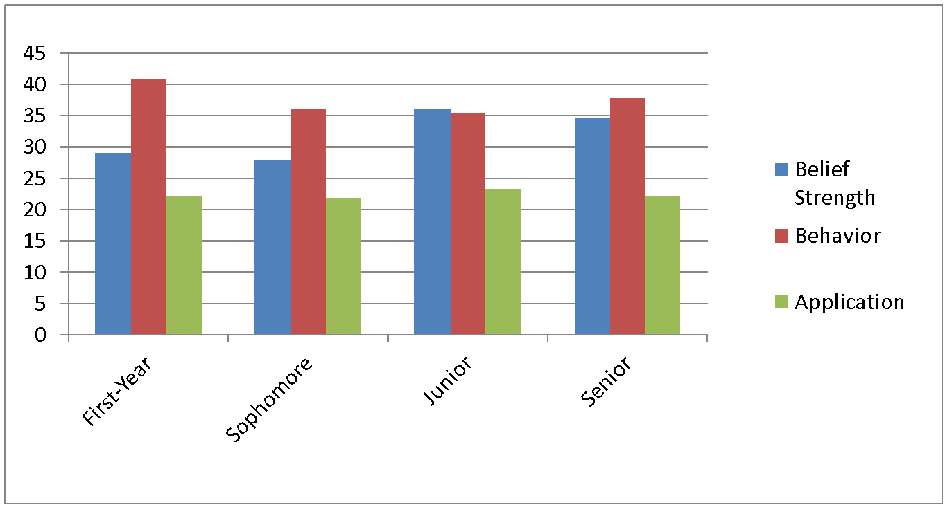
Changes in Faith Development
‹#›
Notes:
‹#›

Slide 6
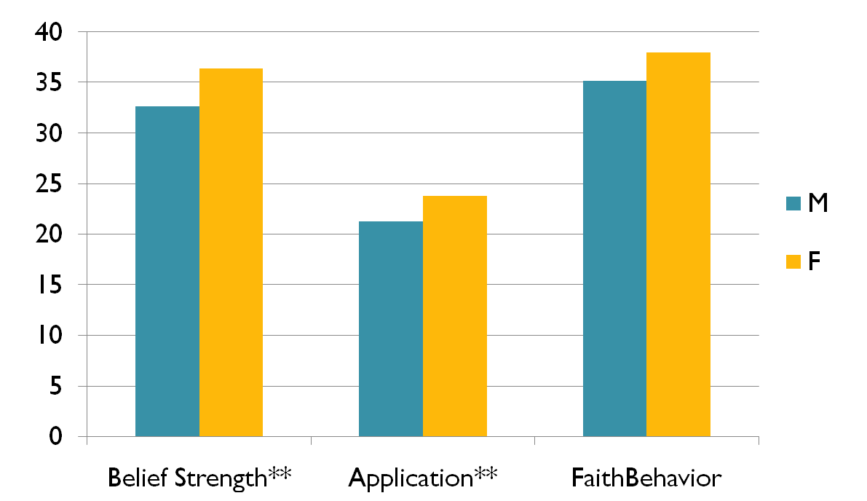
Gender Differences on Faith Measures
‹#›
Notes:
‹#›

Slide 7
Spiritual Struggles
Wondering whether God has abandoned me
Questioning the teachings of my faith
I argue with my parents because of religious beliefs.
I am frustrated with God.

Slide 8
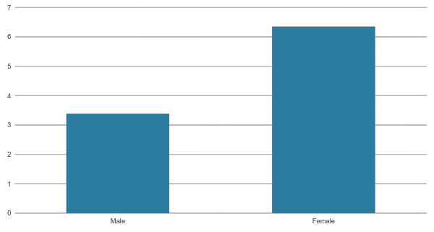
Gender Differences: Negative Religious Coping

Slide 9
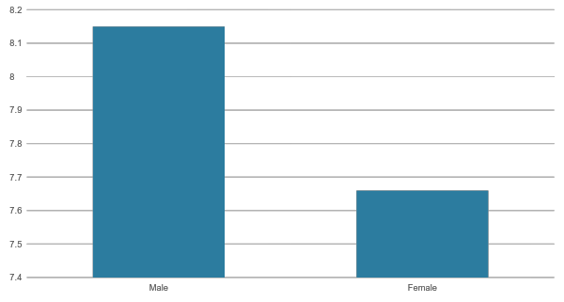
Gender Differences: Doubts

Slide 10
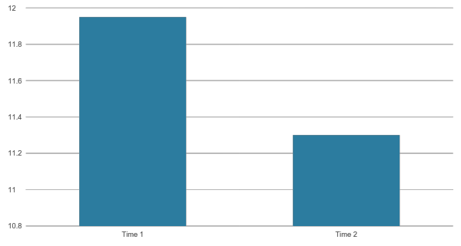
Time Differences: Divine Struggles

Slide 11
Vocation: Discernment and Action Through Service
Subscales | Sample Items
Discernment | I have a good sense of my purpose in life. I know of the many ways that I can use my gifts and talents within the context of my professional career. I have a good sense of God’s purpose for my life.
Action Through Service | I am motivated to choose a career that will enable me to provide some type of service to others. I feel a deep sense of responsibility for reducing pain and suffering in the world.
‹#›
Notes:
‹#›

Slide 12
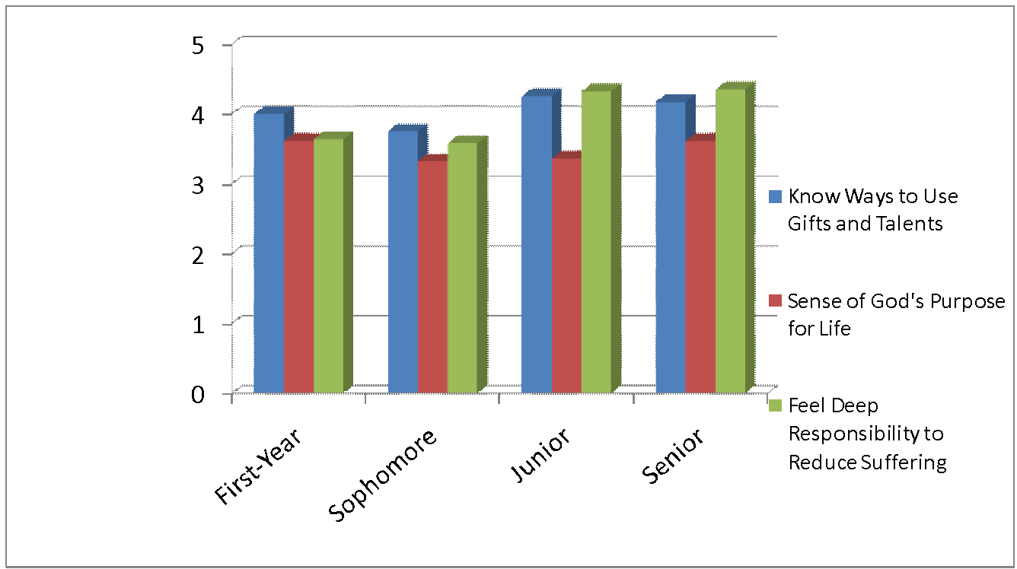
Changes in Vocational
Discernment & Action
‹#›
Notes:
‹#›

Slide 13
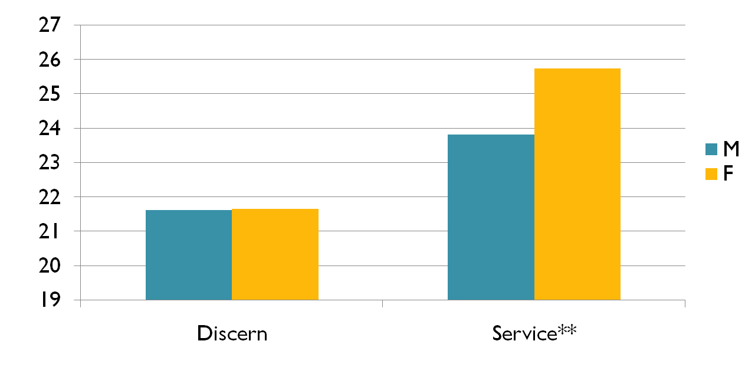
Gender Differences in Vocation Discernment and Action
‹#›
Notes:
‹#›

Slide 14
Vocation Barriers
Subscales | Barriers to Vocation
Personal | Fear Emotional Problems Self-doubt Lack of motivation
Interpersonal | A parent A friend A boy/girl friend A teacher or professor
Social and Cultural | Lack of financial resources Feeling pressure or a desire to get married Feeling that my opportunities are limited by the gender stereotypes of society
‹#›
Notes:
‹#›
The second measure used to asses faith was the faith behavior survey. This survey was also developed particularly for this study. As mentioned before, faith behavior is defined as the individual’s public religious activity, private religious activity, and the experience of spiritual feelings. Therefore, the measure consisted of three subscales assessing each of these domains. Again, several sample items are given here. For example, two sample items assessing public religious activity are: etc.

Slide 15
First-Year Student Survey
Personal Barriers
Fear 51%
Self-Interest 12%
Parents & Family 11%
No Barriers 26%
‹#›
Notes:
‹#›

Slide 16
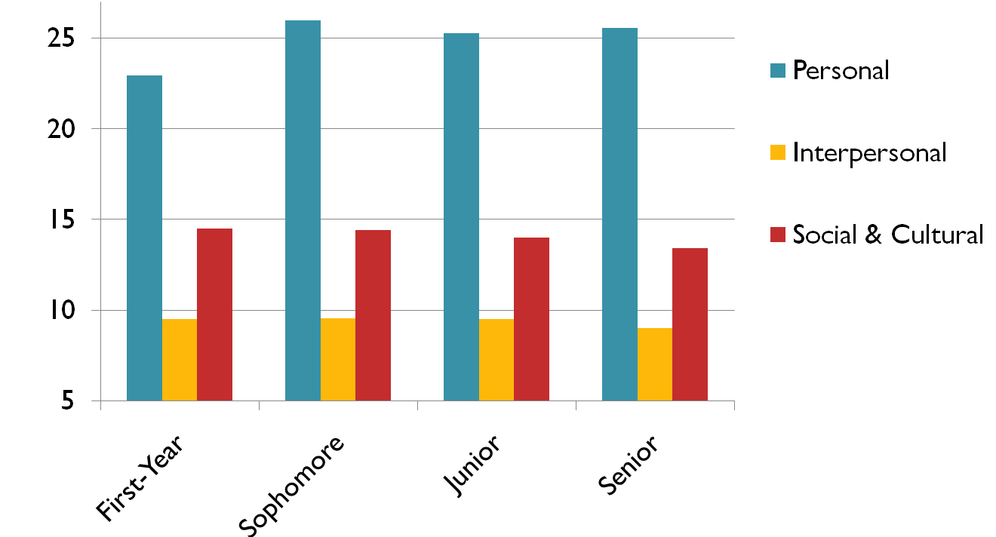
Changes in Vocation Barriers
Over Time
‹#›
Notes:
‹#›

Slide 17
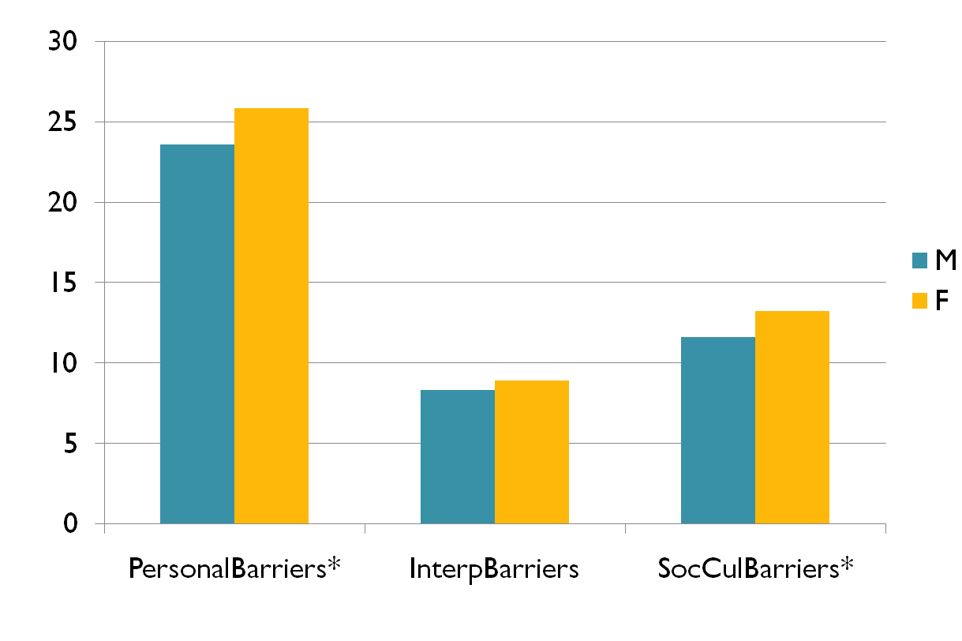
Gender Differences: Vocation Barriers
‹#›
Notes:
‹#›

Slide 18
Conclusions
The college years are a critical time for the development of faith, and vocational calling
The sophomore year is particularly important to this development
Differences between males and females exist on measures of faith, vocation as service, and vocation barriers
Seek Faculty/Staff Mentoring
Belong to a Faith Community
‹#›
Notes:
‹#›

Slide 19
Don Thompson thompson@pepperdine.edu
Cindy Miller-Perrin cperrin@pepperdine.edu
Notes:
‹#›

