Slide 1

Cardiovascular Health Among US and Argentine Students
A Comparative Study of Behaviors and Risk Factors
By: Gina Fitzgerald, Gabriella Smith and Don Thompson

Slide 2
Abstract
Cardiovascular disease for some time has been the leading cause of death in the Western world. Primary prevention is the only way to halt the onset of cardiovascular disease, yet there is little information on the prevalence of risk factors for cardiovascular disease in young adults.
This study seeks to evaluate students from the Catholic University of Argentina and Pepperdine University of America for the prevalence of CVD risk factors, as well as knowledge of CVD and daily habits that contribute to heart health. Thus we compared two cultures with very different lifestyles and prevalence of risk factors.
We hypothesized that students with low prevalence of CVD risk factors are more likely to maintain a normal range of blood pressure and heart rate, and those with high prevalence of CVD risk factors are more likely to have heart rate and blood pressure outside an acceptable range.
A web-based survey assessed 500 students from Buenos Aires, and 500 students from Malibu in the areas of current medical information, personal health history, family health history, personal habits, and knowledge of cardiovascular health. Additionally, blood pressure, heart rate, and demographic information were recorded.
Our research supports our hypothesis: students with greater CVD risk factors displayed increased risk of heart rate and blood pressure outside a healthy range.

Slide 3
Introduction
When researching cardiovascular disease we found little literature sources on the prevalence and risk factors in young adults. As college students, this subject is important in our own lives and the lives of our peers.
According to a study in the Official Journal of the American Academy of Pediatrics, cardiovascular disease is the leading cause of death among adults in the US. In addition, the risk factors for various cardiovascular diseases preexist in childhood and young adults. According to another study by the Journal of American Medical Association, cardiovascular disease is also the leading cause of death among the US Hispanic and Latino population. Often times, the prevalence of CVD and CVD risk factors in Latino individuals are attributed to the lower socioeconomic status held by many of these individuals, especially in the US. While studying abroad in Argentina, a cross-cultural comparative study was proposed that would evaluate CVD in young adults in both the United States and Argentina. We aimed our focus more on if and how the individuals’ personal habits and health histories affect the prevalence of CVD and CVD risk factors in these two populations, keeping socioeconomic status, age, and nationality constant.

Slide 4
Methods
A survey assessed 500 students from Buenos Aires, and 500 students from Malibu in the areas of
  Current medical information
  Personal health history
  Family health history
  Personal habits
  Demographic information
  Knowledge of cardiovascular health.
Additionally, blood pressure, heart rate were recorded.
International students, and those outside the 18-25 age range were omitted from final analysis

Slide 5
Methods
We organized our survey and vital statistics measurements into eight variables:
  1) Body Mass Index (BMI)
  2) Mean Arterial Pressure (MAP)
  3) Resting Pulse
  4) Country
  5) Gender
  6) Health History Composite Score
  7) Health Knowledge Composite Score
  8) Health Habit Composite Score
Notes:
(Target BMI range is 18.50 - 24.99 kg/m²)
: (Target value is 90 mmHg)
(Target value is 80 bpm)
4. (Argentina = 1, US = 2)
5. F=1, M=2
6. based on family health history: high cholesterol, diabetes, coronary artery disease, heart failure, stroke and lower limb artery disease
7. based on individual’s knowledge that: diabetes causes CVD, high cholesterol causes CVD, smoking causes hypertension, smoking causes MI, smoking causes stroke, and smoking causes CVD
8. fast food consumer, participant regular exercise, daily consumer of two fruits & vegetable items, daily consumer of diet soda, daily consumer of soda, former smoker, and current smoker

Slide 6
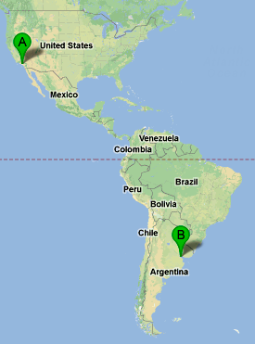
Data
Argentina
  Total Sample Size = 399
  Female Sample Size = 241
    Average Age = 20.47
  Male Sample Size = 158
    Average Age = 20.87
USA
  Total Sample Size = 195
  Female Sample Size = 101
    Average Age = 19.95
  Male Sample Size = 94
    Average Age = 19.82

Slide 7
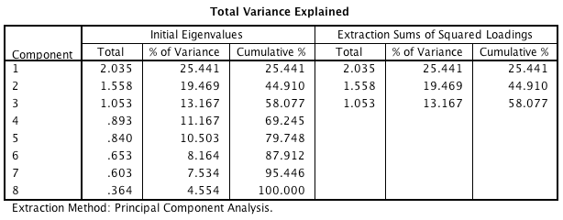
Results
1=BMI
2=MAP
3=Pulse
4=Country
5=Gender
6=Health History Score
7=Health Knowledge Score
8=Health Habit Score

Slide 8
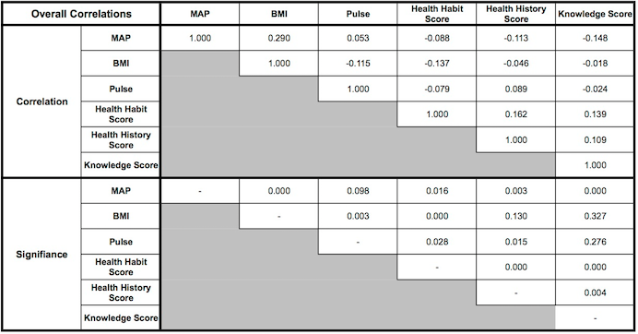
Overall Correlations among survey variables

Slide 9
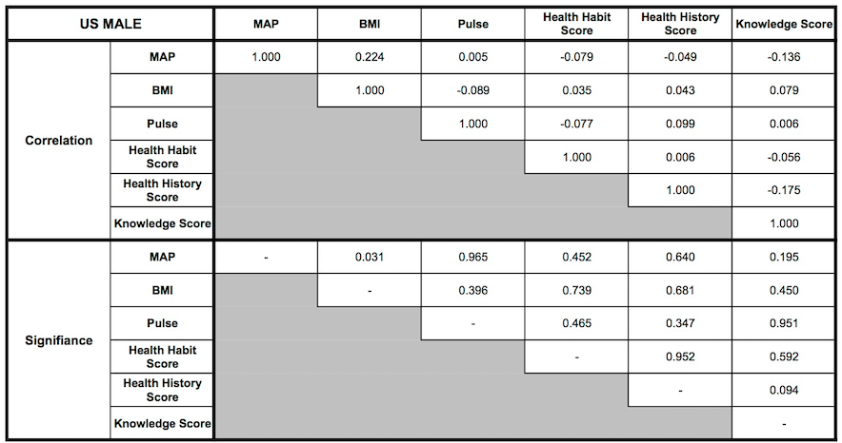
Us Male correlations among survey variables

Slide 10
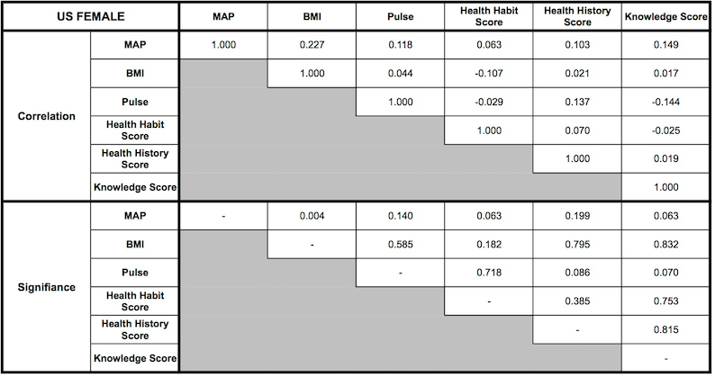
US Female correlations

Slide 11
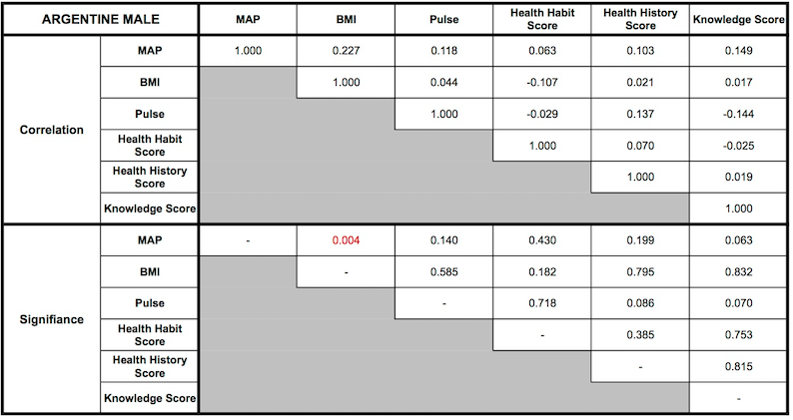
Argentine Male correlations

Slide 12
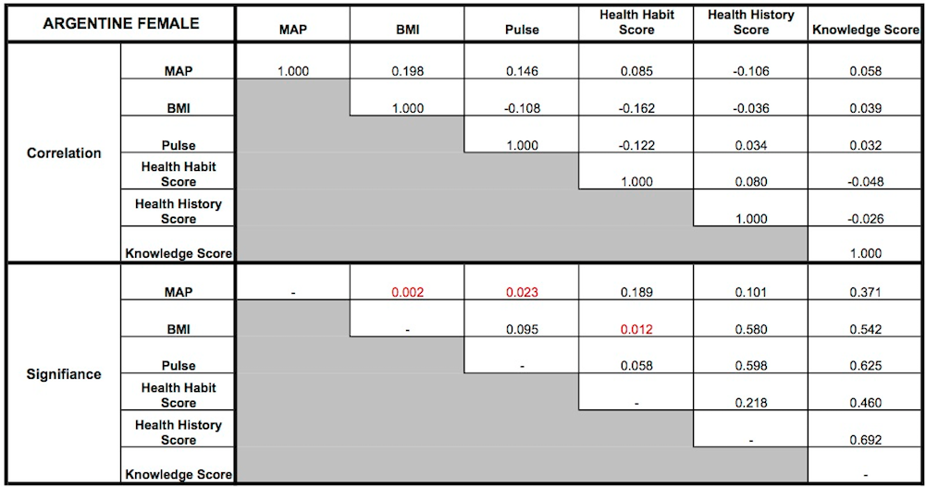
Argentine Female correlations

Slide 13
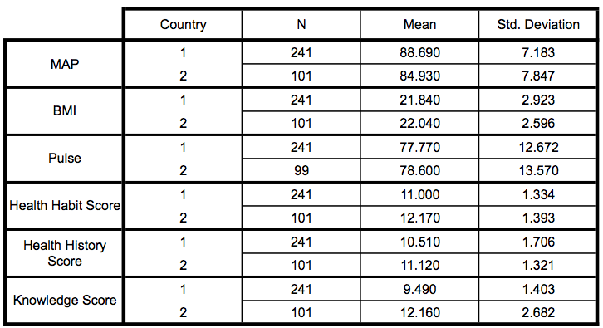
Female group statistics

Slide 14
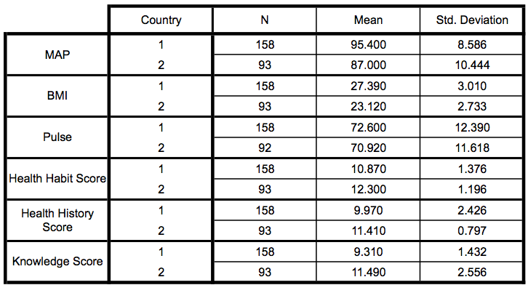
Male group statistics

Slide 15
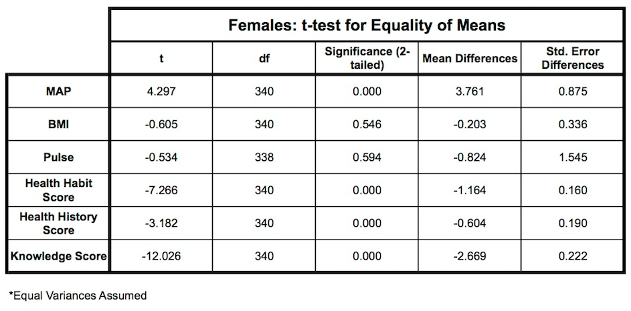
Female T-tests

Slide 16
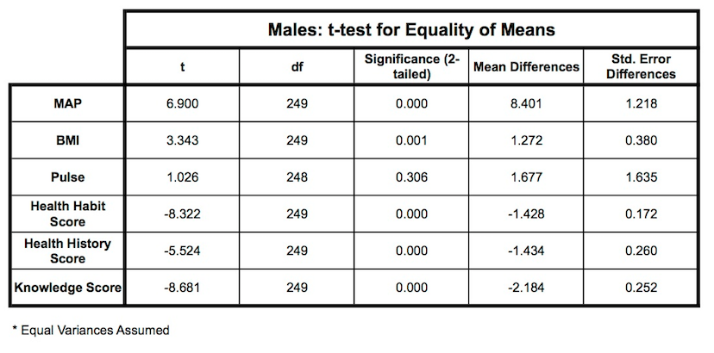
Male T-test

Slide 17
Conclusion
Cross culturally, correlations exist between CVD risk factors and CV behaviors that are consistent in both populations. Mean Arterial Pressure is significantly correlated with
  Health habit,
  health knowledge
  health history
  BMI
T-tests showed that population groups with higher CVD risk factor means also had lower behavior means, indicating that populations with poor CVD behavior correlate with accumulation of CVD risk factors.
We can infer/speculate that a way to improve young adult CV health is to improve health habits and health knowledge.

Slide 18
Future Improvements
Take physical data in more relaxed setting
  More accurate resting heart rates
More comprehensive survey
  Minimize binary (Y/N) questions
  Quantify behavior to greater depth
Track young adults into later adulthood and look for correlation

Slide 19
Acknowledgements
We wish to thank the Natural Science Division and the Buenos Aires International Program of Pepperdine University for their support.

Slide 20
Works Cited
Mathers C, Loncar D (2006) Projections of Global Mortality and Burden of Disease from 2002 to 2030. PLoS Med 3: e442.
May AL, Kuklina EV, Yoon PW. (2012). Prevalence of cardiovascular disease risk factors among US adolescents, 1999-2008. Pediatrics. 2012;129(6):1035-1041
Ministerio de Salud de la Nación (2012) Estadísticas Vitales - Información Básica 2010. In:Dirección de Estadísticas Información de Salud. Retrieved from: http://www.deis.gov.ar/publicaciones/archivos/Serie5Nro52.pdf.
Daviglus ML, Talavera GA, Avilés-Santa ML, Allison M, Cai J, Criqui MH, Gellman M, Giachello AL, Gouskova N, Kaplan RC, LaVange L, Penedo F, Perreira K, Pirzada A, Schneiderman N, Wassertheil-Smoller S, Sorlie PD, Stamler J. (2012). Prevalence of major cardiovascular risk factors and cardiovascular diseases among Hispanic/Latino individuals of diverse backgrounds in the United States. JAMA. 2012;308(17):joc1201051775-1784
Stamler J, Stamler R, Neaton JD, Wentworth D, Daviglus ML, Garside D, Dyer AR, Liu K, Greenland P. (1999). Low risk-factor profile and long-term cardiovascular and noncardiovascular mortality and life expectancy: findings for 5 large cohorts of young adult and middle-aged men and women. JAMA. 1999; 282:2012–2018. [PubMed: 10591383]
Daviglus ML, Liu K, Pirzada A, Yan LL, Garside DB, Feinglass J, Guralnik JM, Greenland P, Stamler J. (2003). Favorable cardiovascular risk profile in middle age and health-related quality of life in older age. Archive of Internal Medicine. 2003; 163:2460–2468. [PubMed: 14609782]
Lloyd-Jones DM, Dyer AR, Wang R, Daviglus ML, Greenland P. (2007). Risk factor burden in middle age and lifetime risks for cardiovascular and noncardiovascular death (Chicago Heart Association Detection Project in Industry). American Journal of Cardiology. 2007; 99:535–540. [PubMed: 17293199]
Berry JD, Dyer A, Cai X, Garside DB, Ning H, Thomas A, Greenland P, Van Horn L, Tracy RP, Lloyd-Jones DM. (2012). Lifetime risk of cardiovascular disease. New England Journal of Medicine. 2012; 366:321–29. [PubMed: 22276822]
Daviglus ML, Liu K, Greenland P, Dyer AR, Garside DB, Manheim L, Lowe LP, Rodin M, Lubitz J, Stamler J. (1998). Benefit of a favorable cardiovascular risk-factor profile in middle age with respect to Medicare costs. New England Journal of Medicine. 1998; 339:1122–1129. [PubMed: 9770560]

Slide 21
Works Cited
Daviglus ML, Liu K, Pirzada A, Yan LL, Garside DB, Greenland P, Manheim LM, Dyer AR, Wang R, Lubitz J, Manning WG, Fries JF, Stamler J. (2005) Cardiovascular risk profile earlier in life and Medicare costs in the last year of life. Archive of Internal Medicine. 2005; 165:1028–1034. [PubMed: 15883242]
Sadakane A, Tsutsumi A, Gotoh T, Ishikawa S, Ojima T, Kario K, Nakamura Y, Kayaba K (2008). Dietary patterns and levels of blood pressure and serum lipids in Japanese population. Journal of Epidemiology. 182:58–67
Nettleton J, Polak J, Tracy R, Burke GDJ (2009) Dietary patterns and incident cardiovascular disease in the multi-ethnic study of atherosclerosis. American Journal of Clinical Nutrition. 90:647–654
Berg C, Lappas G, Strandhagen E, Wolk A, Tore ́n K, Rosengren A, Aires N, Thelle D, Lissner L. (2008). Food patterns and cardiovascular disease risk factors: the Swedish INTERGENE research program. American Journal of Clinical Nutrition. 88:289–297
Tourlouki E, Matalas A, Panagiotakos D. (2009). Dietary habits and cardiovascular disease risk in middle-aged and elderly populations: a review evidence. Clinical Interventions in Aging. 4:319–330
Mikkilä V, Räsänen L, Raitakari O, Marniemi J, Pietinen P, Ro ̈nnemaa T, Viikari J (2007) Major dietary patterns and cardiovascular risk factors from childhood to adulthood. The cardiovascular risk in young finns study. British Journal of Nutrition 98:218–225
Lloyd-Jones DM, Hong Y, Labarthe D, Mozaffarian D, Appel LJ, Van HL, Greenlund K, Daniels S, Nichol G, Tomaselli GF, Arnett DK, Fonarow GC, Ho PM, Lauer MS, Masoudi FA, Robertson RM, Roger V, Schwamm LH, Sorlie P, Yancy CW, Rosamond WD. (2010). Defining and setting national goals for cardiovascular health promotion and disease reduction: the American Heart Association’s strategic Impact Goal through 2020 and beyond. Circulation. 2010; 121:586–613.
Oikonen M, Laitinen TT, Magnussen CG, Steinberger J, Sinaiko AR, Dwyer T, Venn A, Smith KJ, Hutri- Kähönen N, Pahkala K, Mikkilä V, Prineas R, Viikari JSA, Morrison JA, Woo JG, Chen W, Nicklas T, Srinivasan SR, Berenson G, Juonala M, Raitakari OT. (2013). Ideal Cardiovascular Health in Young Adult Populations From the United States, Finland, and Australia and Its Association With cIMT: The International Childhood Cardiovascular Cohort Consortium. Journal of American Heart Association 2013;2:e000244 doi: 10.1161/JAHA.113.000244)
Dong C, Rundek T, Wright CB, Anwar Z, Elkind MS, Sacco RL. (2012). Ideal cardiovascular health predicts lower risks of myocardial infarction, stroke, and vascular death across whites, blacks, and hispanics: the northern Manhattan study. Circulation. 2012;125:2975–2984.
Ford ES, Greenlund KJ, Hong Y. (2012). Ideal cardiovascular health and mortality from all causes and diseases of the circulatory system among adults in the United States. Circulation. 2012;125:987–995.
Yang Q, Cogswell ME, Flanders WD, Hong Y, Zhang Z, Loustalot F, Gillespie C, Merritt R, Hu FB. (2012). Trends in cardiovascular health metrics and associations with all-cause and CVD mortality among US adults. JAMA. 2012;307:1273–1283.

