Slide 1
The Effects of Study Abroad on
Intellectual, Social, Personal and Spiritual Transformation
International Programs
Directors Meeting
May 2, 2013
Christian Spirituality Research Institute
Pepperdine University
Don Thompson
Cindy Miller-Perrin

Slide 2
Longitudinal Design
  Spring Survey
    First-Year, Sophomore, Junior, Senior
    1200 Subjects Participate Annually
Survey Measures
  Ego Identity
  College Student Behavior
  Emotional Awareness
  Mentor/Protégé Reflection
  Several Faith Measures
  Vocational Discernment & Action
  Barriers to Life Purpose
  Perceived Well Being

Slide 3
Faith Attitude & Behavior Survey
3
Subscales | Sample Items
Strength of Beliefs (α = 0.73) | I view myself as a religious person I have doubts about whether my religious beliefs are true
Importance of Faith (α = 0.89) | Religion is not a very important part of my life right now My faith is not very important to me
Life Application of Faith (α = 0.92) | I depend on my faith in God for decision-making and direction I try hard to carry my religious beliefs into all other dealings in my life
Faith Behavior (alpha = .88) | How often do you attend religious services How often have you read a devotional, religious, or spiritual book in the last year

Slide 4
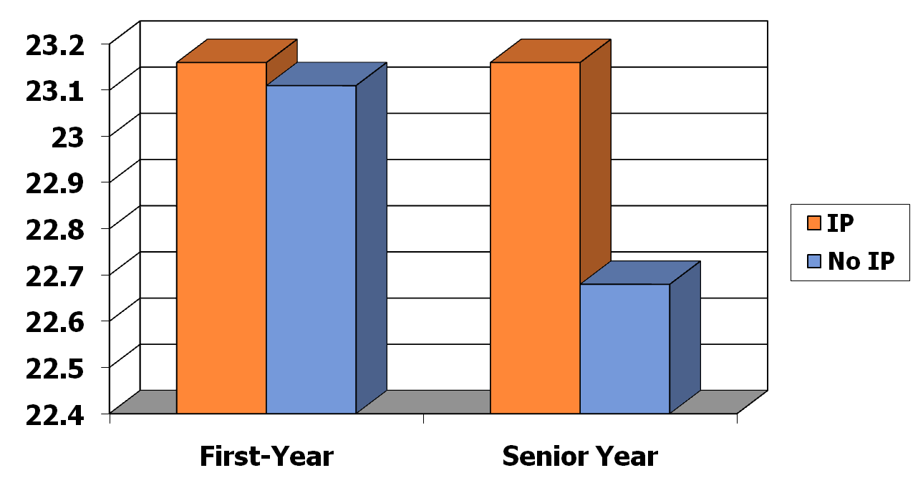
Strength of Belief
First-Year and Senior Time Periods ***
4

Slide 5
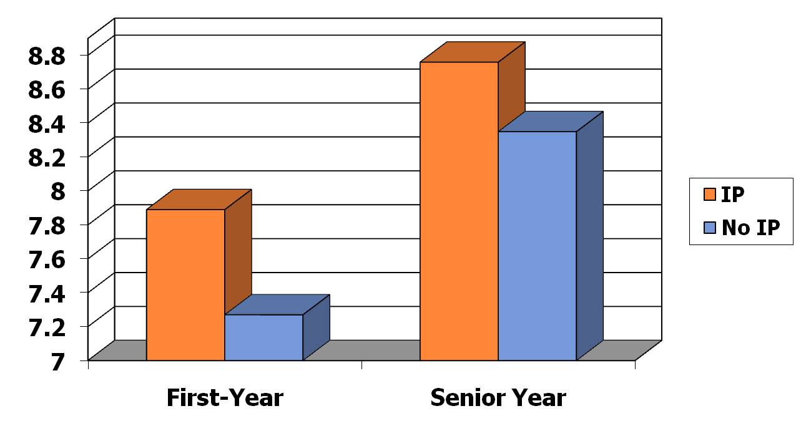
Faith Importance
First-Year and Senior Time Periods ***
5

Slide 6
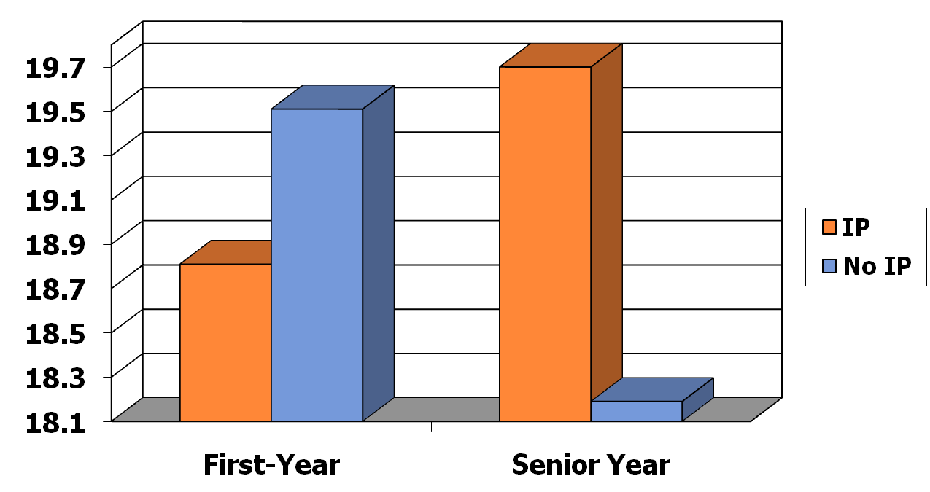
Faith Application
First-Year and Senior Time Periods ***
6

Slide 7
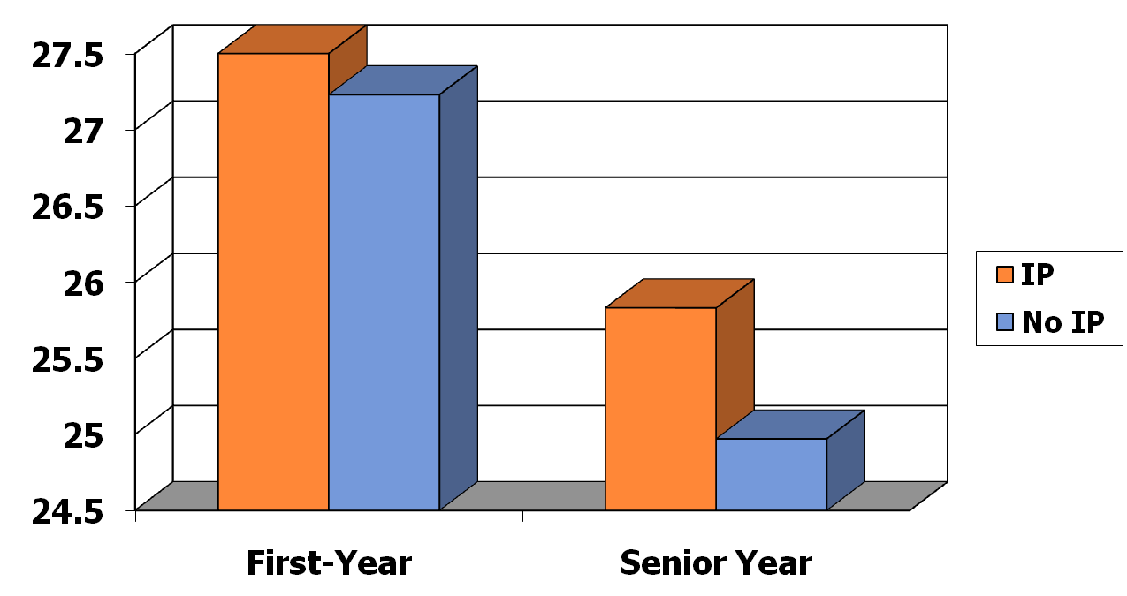
Faith Behavior
First-Year and Senior Time Periods ***
7

Slide 8
Vocational Discernment and Action
Subscales | Sample Items
Discernment and Purpose (α = .76) | I have a good sense for my life purpose I know of the many ways that I can use my gifts and talents within the context of my professional career I am unsure about what God is specifically calling me to do (Reverse)
Service to Others (α = .68) | I am motivated to choose a career that will enable me to provide some type of service to others I feel a deep sense of responsibility for reducing pain and suffering in the world
8

Slide 9
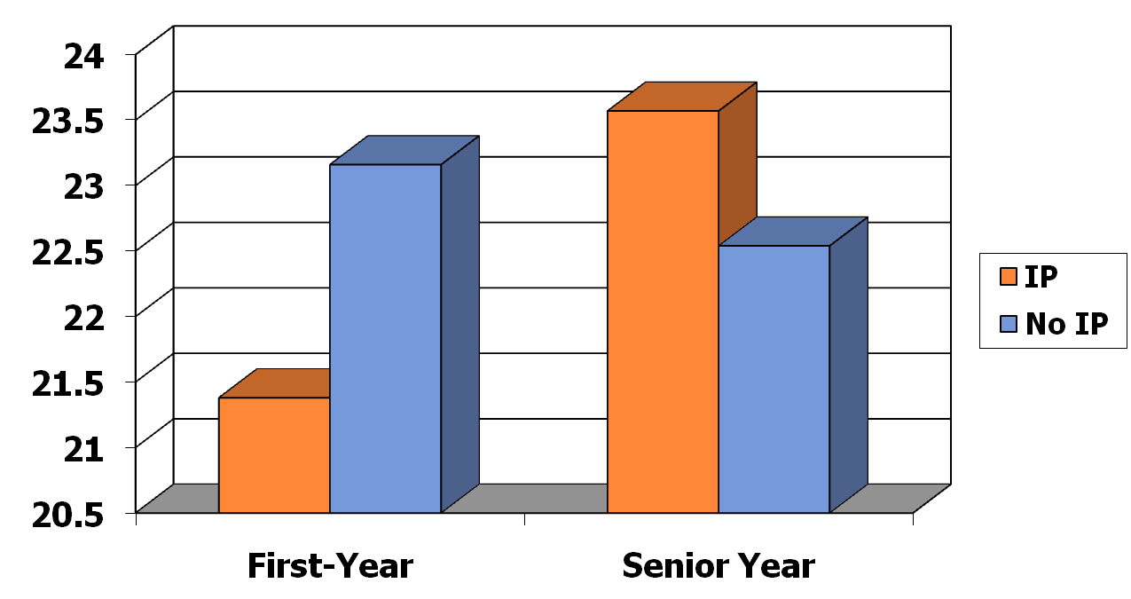
Discernment
First-Year and Senior Time Periods ***
9

Slide 10
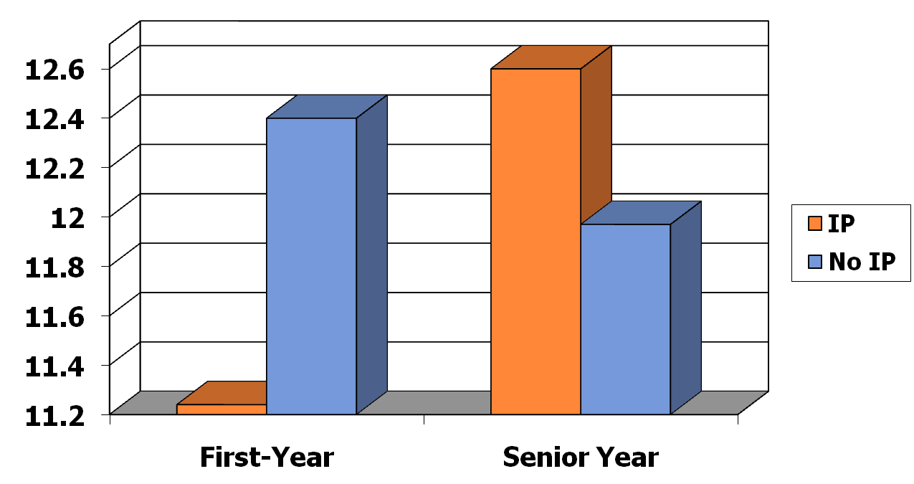
Service
First-Year and Senior Time Periods ***
10

Slide 11
The Sophomore Experience:
College as Rite of Passage:
Departure, Initiation, & Return
Impact of Study Abroad at Pepperdine
Research Hypothesis
  Students participating in an International Program experience greater intellectual, social, personal and spiritual transformation than those students who do not participate.
Measures
  Ego Identity
  Emotional Awareness: Appraisal & Expression, Regulation, Utilization
  Global Awareness: Empathy, Action
Longitudinal Design
  Fall 2010 – Pre – Fall of First Year (Application Year)
  Spring 2012 – Mid – Spring of Sophomore Year (IP Year)
  Fall 2012 – Post – Fall of Junior Year (Return Year)

Slide 12
Sampling
Fall 2010 (Pre)
  880 students apply to study abroad in 2011-12
Spring 2012 (Mid)
  210 IP students re-survey
  116 NOIP students re-survey
Fall 2012 (Post)
  90 IP students re-survey
  32 NOIP students re-survey

Slide 13
Ego Identity Status Measure
13
  Diffusion: no exploration or commitment (-,-)
    “I haven’t really considered politics. It just doesn’t excite me much.”
  Foreclosure: no exploration, but commitment (-,+)
    “My parents decided a long time ago what I should go into for employment and I’m following through with their plans.”
  Moratorium: exploration without commitment (+,-)
    “Religion is confusing to me right now. I keep changing my views on what is right and wrong for me.”
  Achievement: exploration and commitment (+,+)
    “It took me a while to figure it out, but now I really know what I want for a career.”

Slide 14
Foreclosure **
14
Notes:
14

Slide 15
Achievement **
15
Notes:
15

Slide 16
Schutte Self-Report Inventory
Emotional Awareness Measure
Appraisal and Expression
  Other people find it easy to confide in me
  Some of the major events of my life have led me to re-evaluate what is important and not important
  I am aware of my emotions as I experience them
Regulation
  I seek out activities that make me happy
  When I am in a positive mood, solving problems is easy for me
  I have control over my emotions
Utilization
  I am aware of the non-verbal messages other people send
  When I feel a change in emotions, I tend to come up with new ideas
  When I am faced with a challenge, I give up because I believe I will fail (Reverse Coded)
16
Notes:
16

Slide 17
Regulation *
17
Notes:
17

Slide 18
Utilization *
18
Notes:
18

Slide 19
Global Awareness Measures
Empathy
  I have a duty to improve the world
  I enjoy spending time with people from other racial/ethnic/cultural groups
  I often think about how my personal decisions affect the welfare of others
Action
  I contribute money to international relief efforts
  I am involved with organizations that provide help for people in other countries
  I am one to speak up about racial injustice
19
Notes:
19

Slide 20
Empathy ***
20
Notes:
20

Slide 21
Factors Contributing to Transformation in International Programs
21
Travel
  Departure & Initiation
Mentoring
  Initiation
Community
  Initiation & Return

Slide 22
Don Thompson thompson@pepperdine.edu
Cindy Miller-Perrin cperrin@pepperdine.edu

