Slide 1
INVESTIGATING DRAWING AS A COGNITIVE STRATEGY
IN UNDERGRADUATE LINEAR ALGEBRA COURSE
Milé Krajcevski
University of South Florida
mile@mail.usf.edu
Joint Mathematics Meetings, San Diego, January 10-13, 2018

Slide 2
OUTLINE
• Cognitive power of visualization in science
and mathematics.
• Visualizing Linear Algebra.
• Drawing-to-learn approach to Linear Algebra

Slide 3

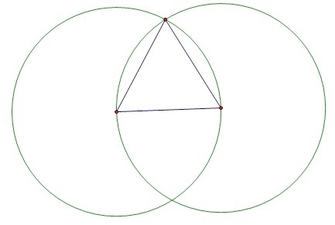
Euclid’s Elements, Proposition 1
To construct an equilateral triangle on a given finite straight line
Notes:
Starting with Euclid’s Elements and until XIX century, mathematicians
attempted to formalize (in logical terms) human perception of reality

Slide 4
Girolamo Sacchieri’s quadrilateral
“The Hypothesis of the Acute Angle is absolutely false,
being repugnant to the nature of the straight line”

Slide 5
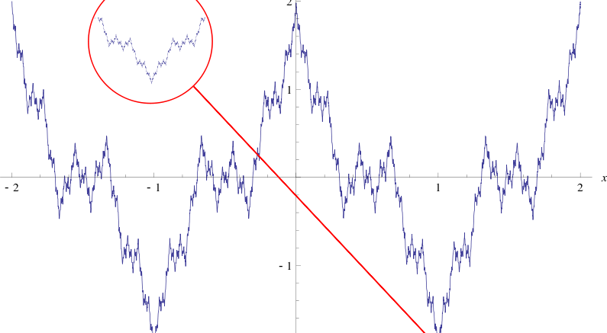
Karl Weierstrass’ continuous everywhere but differentiable nowhere (1872)

Slide 6
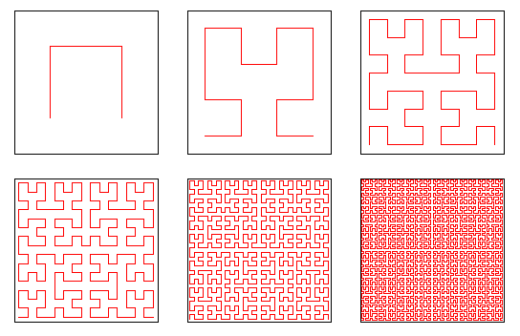
Peano’s space-filling curve (1890)
Is it possible that plane curves which are mathematical objects, may possess properties
that are so disparate from the physical properties of ropes which apparently they
are supposed to represent. Is our intuition that unreliable?
Notes:
We assert that intuition and visualization, which can be seen as the most powerful tools for our cognition, do not have an open access to the mathematical facts but rather they are regulated by our acquired knowledge and expertise.

Slide 7
We mathematicians need to put far greater effort into communicating mathematical ideas. To accomplish this, we need to pay much more attention to communicating not just our definitions, theorems, and proofs, but also our ways of thinking. We need to appreciate the value of different ways of thinking about the same mathematical structure.
William P. Thurston
On proof and progress in mathematics (p 168)
Bulletin of AMS Vol 30, #2, April 1994
e

Slide 8
Phillips, Norris and Macnab
Visualization in Mathematics, Reading and Science Education, Springer 2010
Visualization objects are physical objects that are viewed and interpreted by a person for the purpose of understanding something other than the object itself. These objects can be pictures, 3D representations, animations, etc.
Introspective visualization
Interpretive visualization
Notes:
INTROSPECTIVE VISUALIZATION OBJECTS are mental objects that a person makes that are believed to be similar to visualization objects. Introspective visualization is an imaginative construction of some possible visual experience.
INTERPRETIVE VISUALIZATION is an act of making meaning from a visualization object or an introspective visualization by interpreting information from the objects or introspections and by cognitively placing the interpretation within the person’s existing network of beliefs, experiences, and understanding.

Slide 9
Following Quillin and Thomas
Drawing - to - Learn: A Framework for Using Drawings to Promote Model-Based Reasoning in Biology
CBE-Life Sciences Education, Vol.14, 1-16, Spring 2015
Drawing-to-learn is a learner-generated activity in which practitioners create a 2D external representation of a mathematical object, proposition or a configuration on any medium, for the purpose
of understanding something other than the object itself.

Slide 10
Diminishing role of geometry in high school
curriculum is contributing factor for students reluctance to ”explore visual thinking”
in problem solving situations.

Slide 11
How much geometry do we need?
a
α
β
β
α
β
α
γ
b
a||b → α=β
α+β+γ= π
α = β
A
c
b
D
b
f
a
a
C
B
E
d
F

Slide 12
α
or…
α
α
2α
sinα
α
cosα

Slide 13
Our own research indicates that …
Students are capable of producing/drawing reasonably good images of lines, polygons, circles, cubes, during an enacted lession, but...
… they would rearly reach for a visual representation of a given problem even in cases when it will significantly reduce the complexity of the problem and provide an appealing path towards successful resolution.
Students’ inclination to use visual images during problem solving
Krajcevski and Keene, SIGMAA on RUME 2017, San Diego
Notes:
Students must be encouraged to draw models or to present their interpretations of the mathematical notions they encounter
if we want to help them solve problems.

Slide 14
z ⁺
z ⁺
x ⁻
y ⁺
y ⁻
x ⁺
y ⁺
x ⁻
x ⁺
y ⁻
z ⁻
z ⁻
Viewer in the first octant
Viewer in the fifth octant
Notes:
We designed a course in which the visual components of the subject are “on equal footing” as the analytic (computational) components .

Slide 15
THE BOX

Slide 16
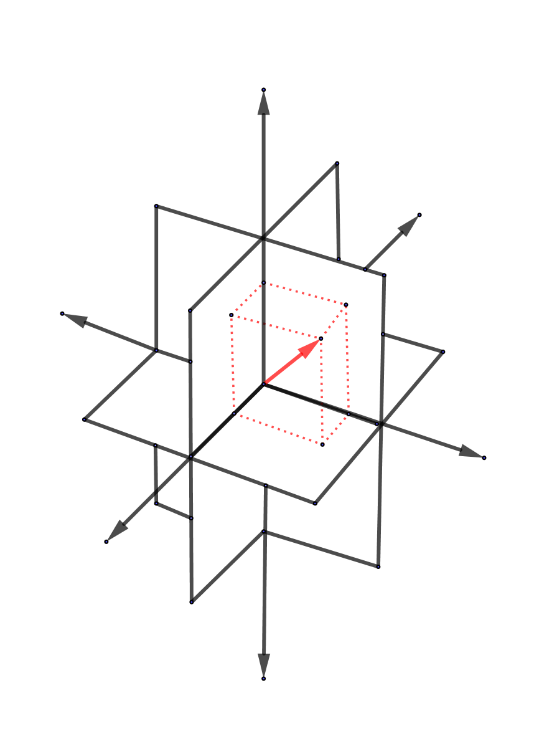

Slide 17
Given vectors u, v, and w as shown, let T be a linear transformation that transforms vectors u and v to vectors T(u) and T(v) respectively.
Sketch the vector T(w).
v
T(v)
T(w)=?
w
O
T
O
T(u)
u
Also sketch the vector T( u + 2v).

Slide 18
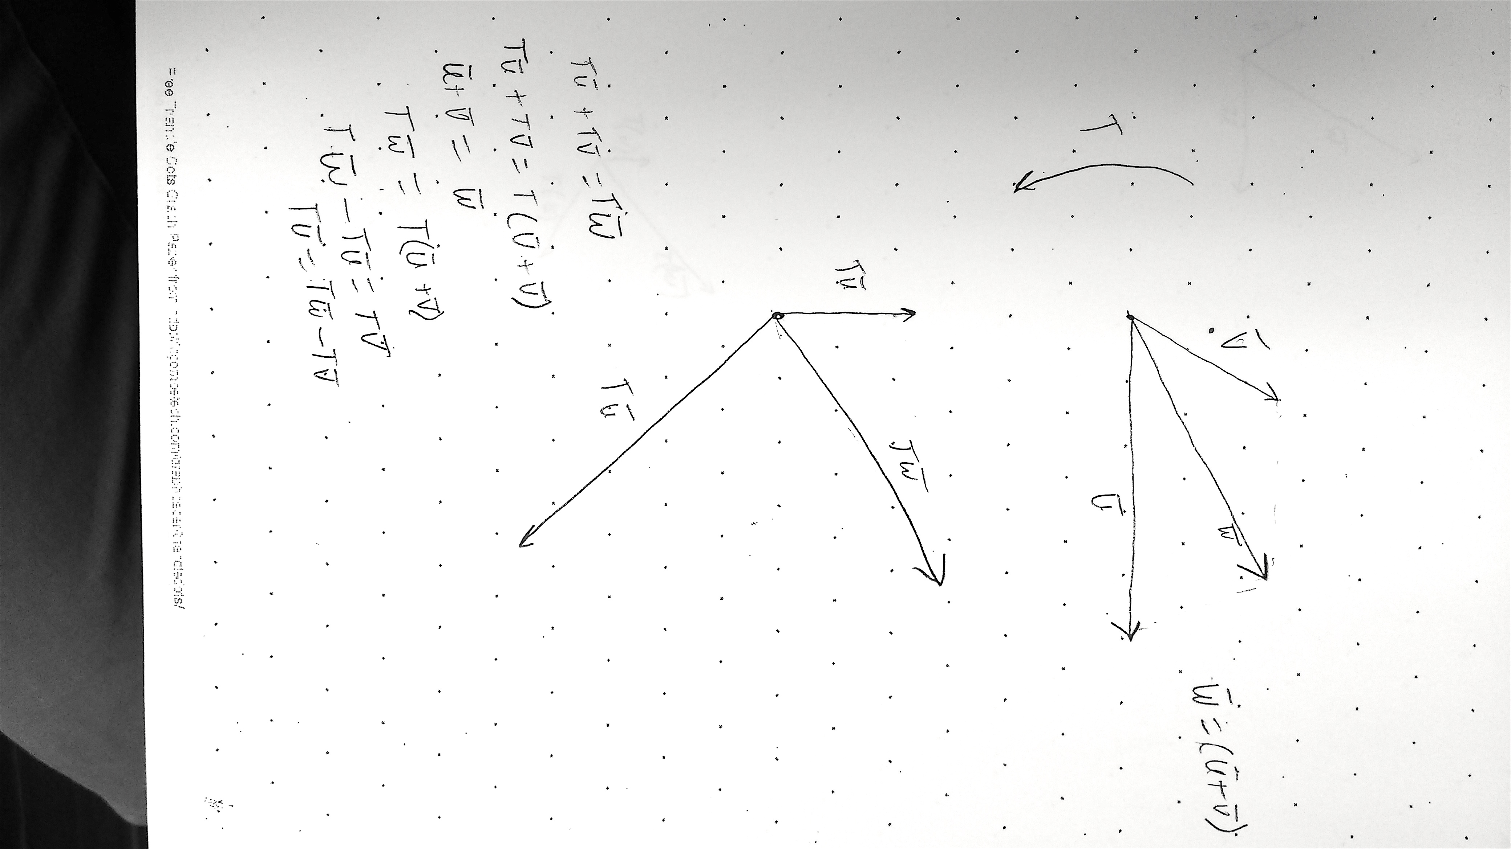
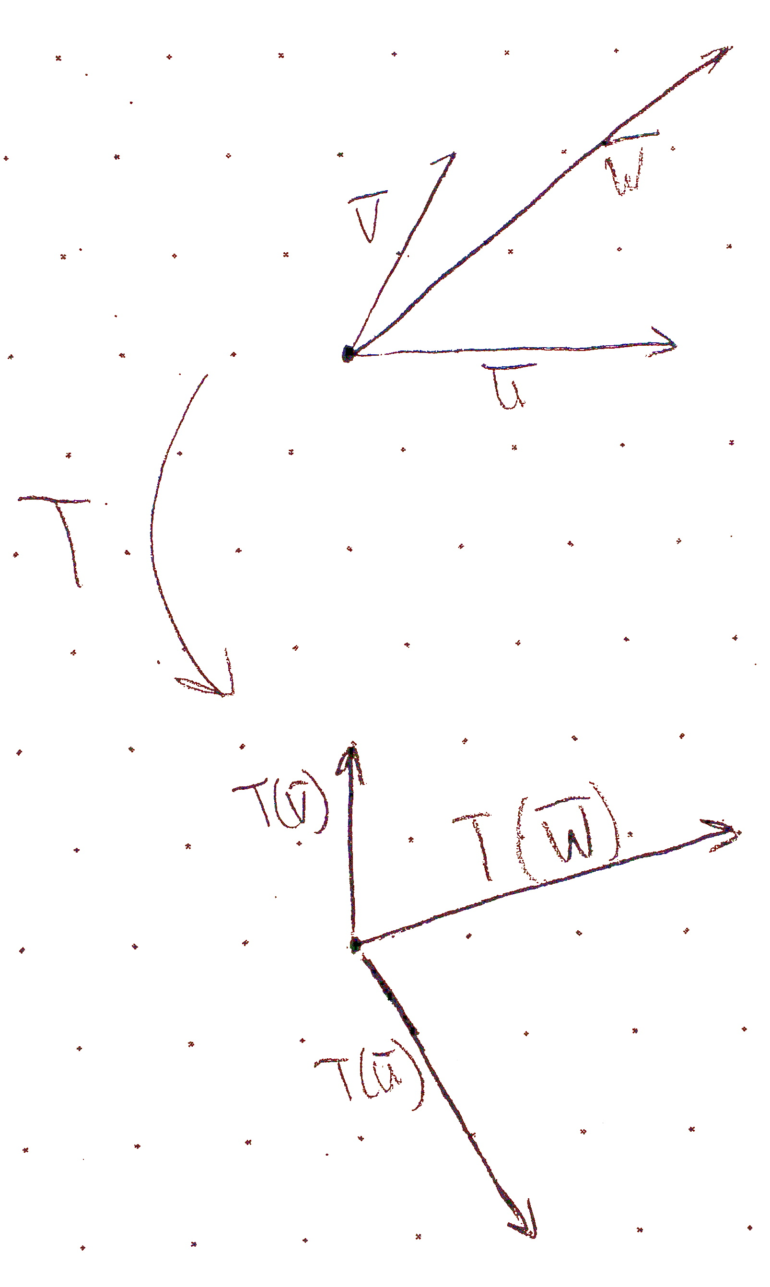
Student A
Student B

Slide 19
We are given a linear transformation in the plane that maps vector i to vector a and vector j to vector b as shown on the figure.
Sketch the image of the letter K under this linear transformation.

Slide 20
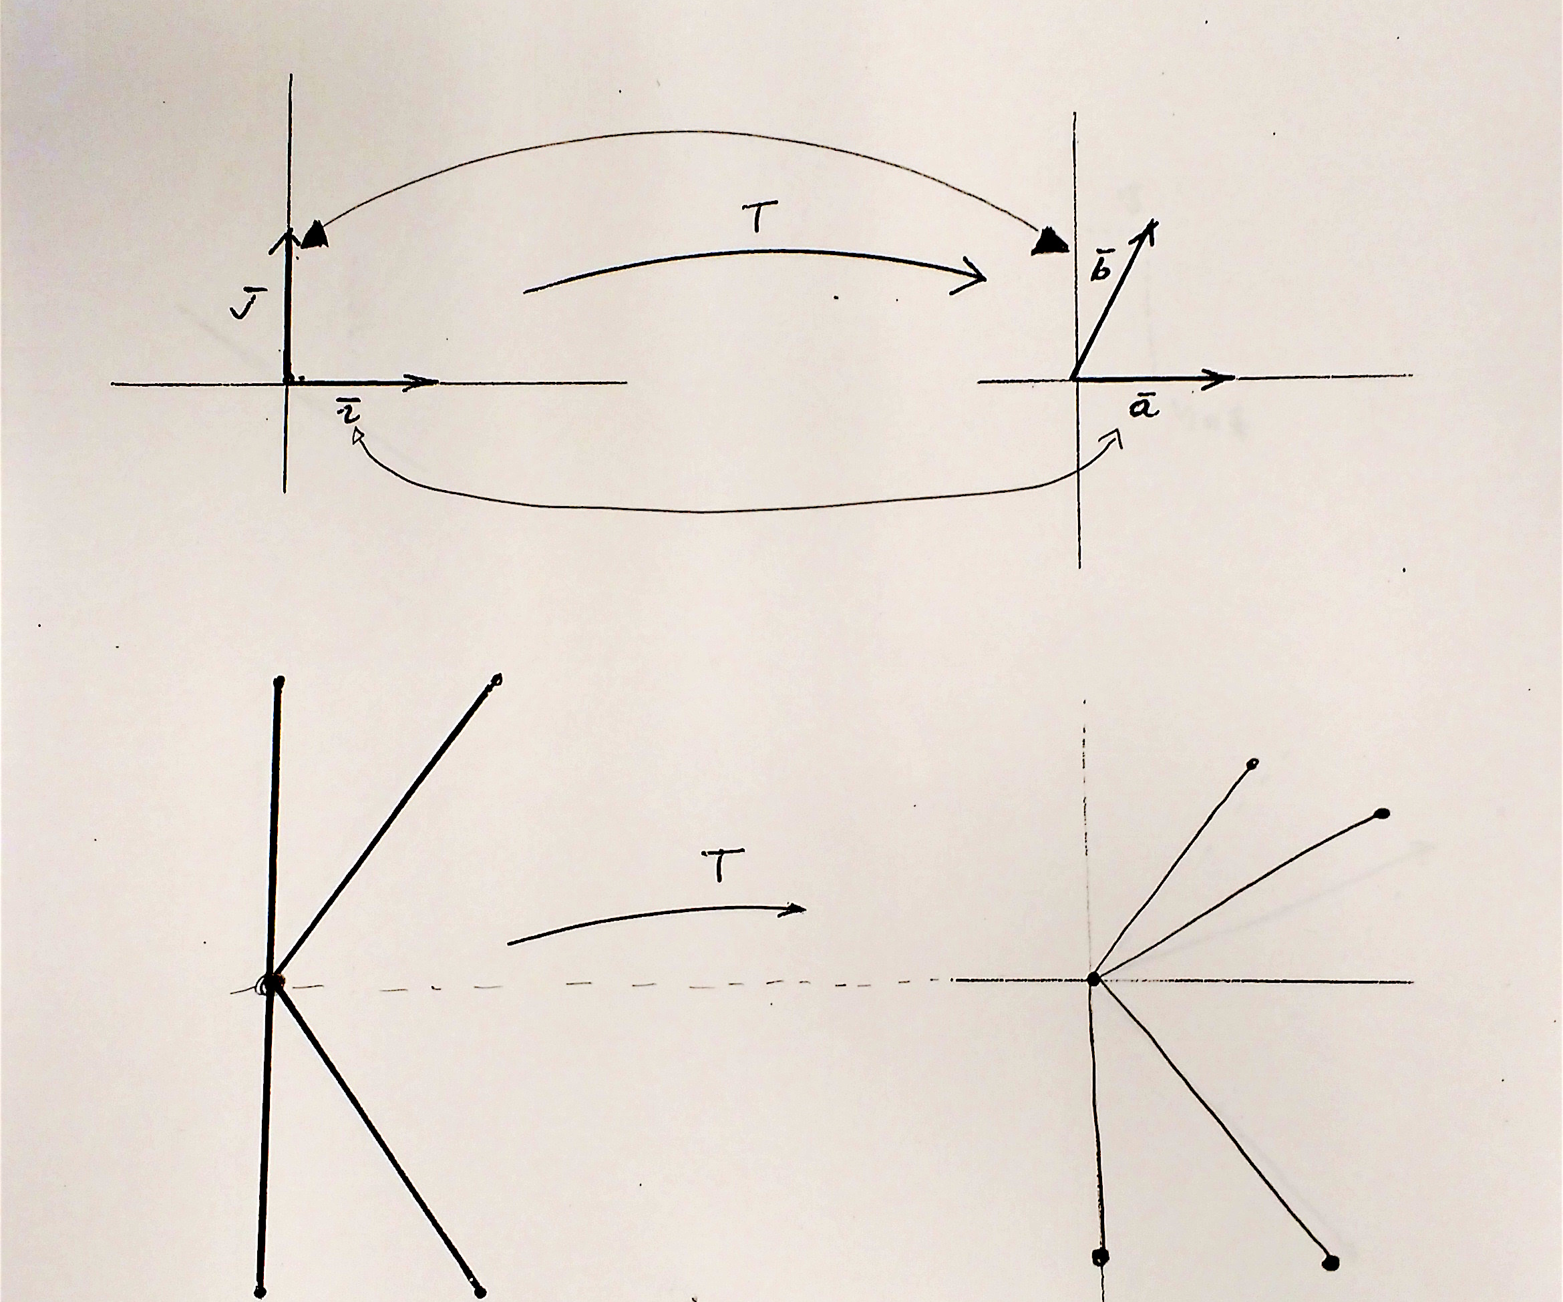
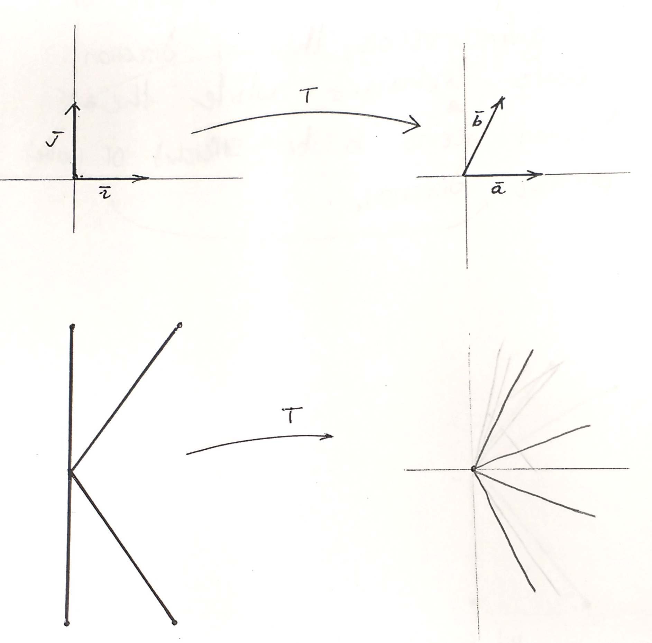
Student C
Student D

Slide 21
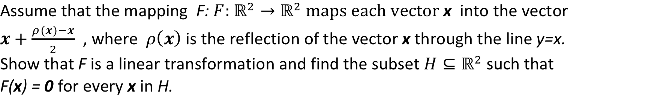

Slide 22
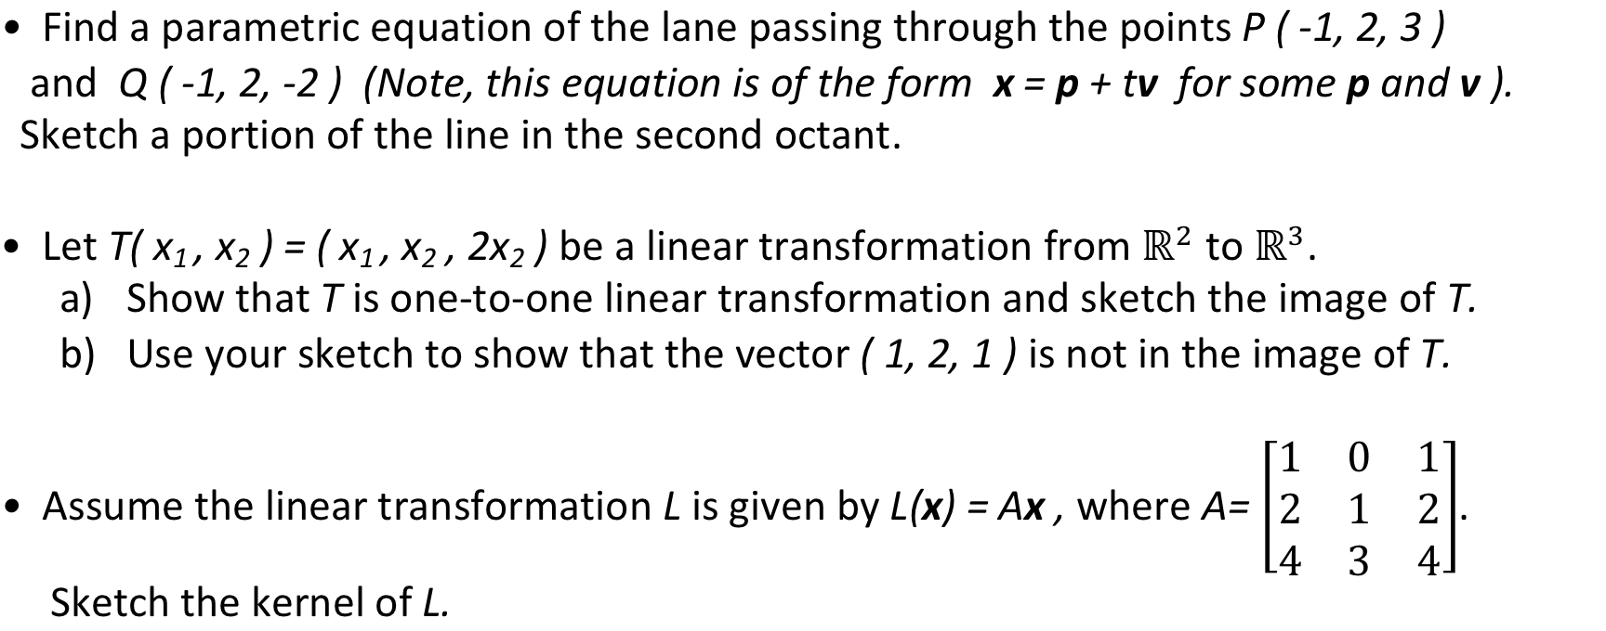

Slide 23
What are some of the obvious obstacles to implementation of drawing
• Instructors reluctance to draw.
• Difficulty in assessing student work and giving
an adequate feedback in large classes.
• Student prejudges towards drawing seen as
“non-mathematical activity”.

Slide 24
Some open questions
• What are the best strategies to convey the advantages of
drawing-to-learn activity in a linear algebra classroom?
• What are the differences in a type of medium used (paper,
whiteboard, electronic device…) when visualizing?
• Which linear algebra notions are most accessible to
visualization?
• How may visualization be harnessed to promote mathematical
abstraction and generalization? (Presmeg)

Slide 25
Thank you

