Slide 1
An Introduction to Linear Algebra
David Strong
Pepperdine University

Slide 2
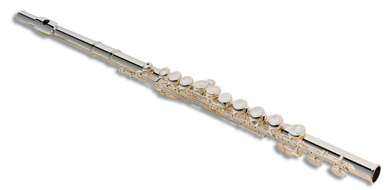
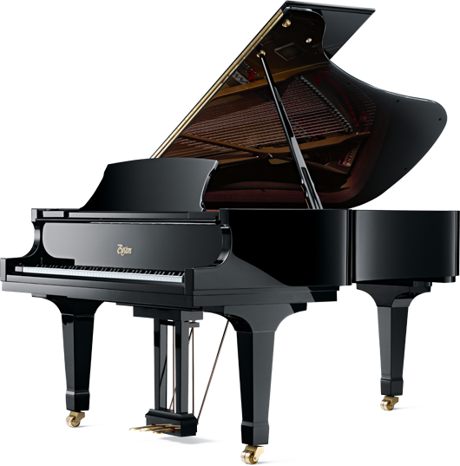
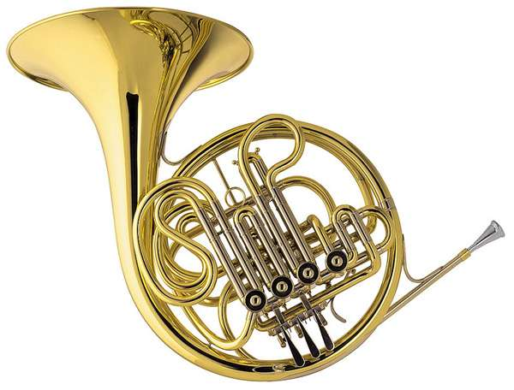
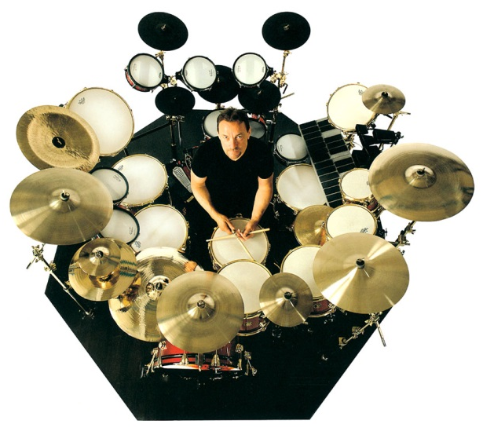
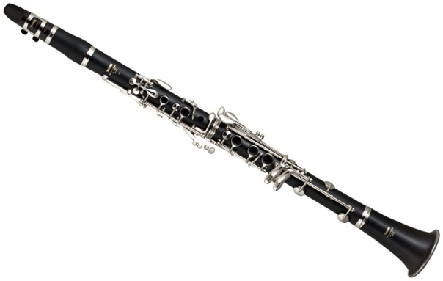
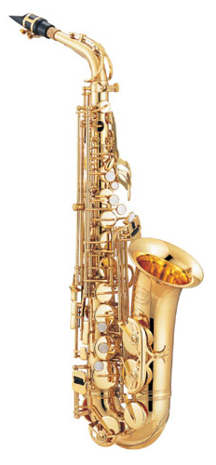
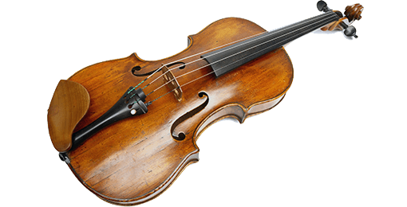
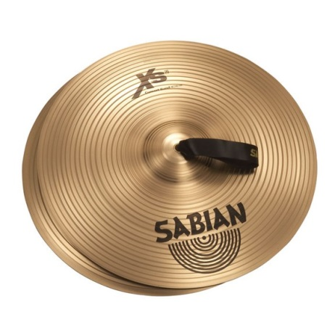
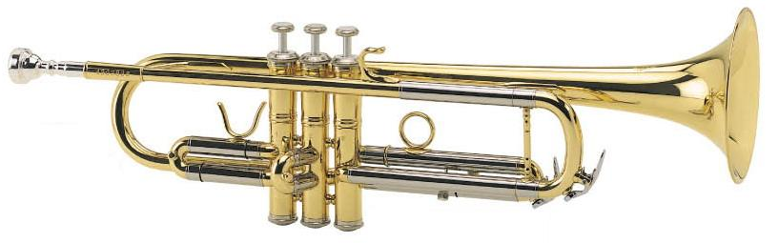
Imagine a musical world of only pianos...
Notes:
Click to start music. Imagine a world in which pianos were the only musical instrument.
Click to start animation. No trumpets. No flutes. No saxophones. No harps. No cymbals or other percussion. No french horns. No clarinets. No drums. And no violins, violas or other stringed instruments.
While pianos are pretty versatile, there are a lot of other instruments that are pretty cool.
That would be a pretty bland musical world.

Slide 3
…thank goodness for other instruments!
Notes:
Turn volume up a bit.
Music starts on its own.
Click to start animation.

Slide 4
Imagine a mathematical world of only Calculus…
While Calculus is an important part of mathematics, there is so much more to mathematics than simply Calculus and the ideas (such as arithmetic, algebra, geometry, trigonometry, etc.) that lead to Calculus.
Notes:
Turn volume down quite a bit.
Calculus is very useful, and to a lot of mathematicians, it’s pretty cool.
But just as there is so much more to music than pianos, there is so much more to mathematics than Calculus.

Slide 5
Speech Recognition
Mathematical Geology
Dynamical Systems
Criminology
There is infinitely more
to mathematics
beyond
Topology
Data Compression
Mathematical Finance
Actuarial Science
Complex Analysis
Game Theory
Probability
Operations Research
Linear Algebra
Calculus
Mathematical Logic
Graph Theory
Statistics
Cryptography
Mathematical Biology
Combinatorics
Fourier Analysis
Mathematical Physics
Differential Equations
Number Theory
Voting Theory
Data Analysis
Mathematical Modeling
Imaging Science
Notes:
Don’t need to click to start!!
Quickly bring volume back up as words appear.
Drop volume again before next slide.

Slide 6
Results are in: the top career is…
Notes:
So every year various organizations rank all sorts of careers.
Have you ever wondered what the best careers are?

Slide 7
Mathematician
Notes:
Mathematician. So what is it that makes being a mathematician so cool and rewarding?
What do mathematicians know that the everyone else does not?
Do they just really love to do Calculus?
Some mathematicians do, but most work in other areas of mathematics.
Is there more to mathematics than Calculus?
There are dozens of other very interesting and extremely useful areas of mathematics.

Slide 8
Speech Recognition
Mathematical Geology
Dynamical Systems
Criminology
Topology
Data Compression
Mathematical Finance
Actuarial Science
Complex Analysis
Game Theory
Probability
Operations Research
Linear Algebra
Calculus
Mathematical Logic
Graph Theory
Statistics
Cryptography
Mathematical Biology
Combinatorics
Fourier Analysis
Mathematical Physics
Differential Equations
Number Theory
Voting Theory
Data Analysis
Mathematical Modeling
Imaging Science
Notes:
So there are dozens, perhaps hundreds, of different areas of mathematics beyond Calculus.
(Wait for linear algebra.)
Today we’ll talk for a few minutes about an area of Linear Algebra. We’ll talk about it since it is often the first course students take in college beyond Calculus, and since it is a really beautiful and useful areas of mathematics.

Slide 9
Some applications of
Linear Algebra
Notes:
Obviously we can’t go into too much depth about what Linear Algebra is in just these few minutes that we have together today. So let’s start with a few of the applications of Linear Algebra.

Slide 10
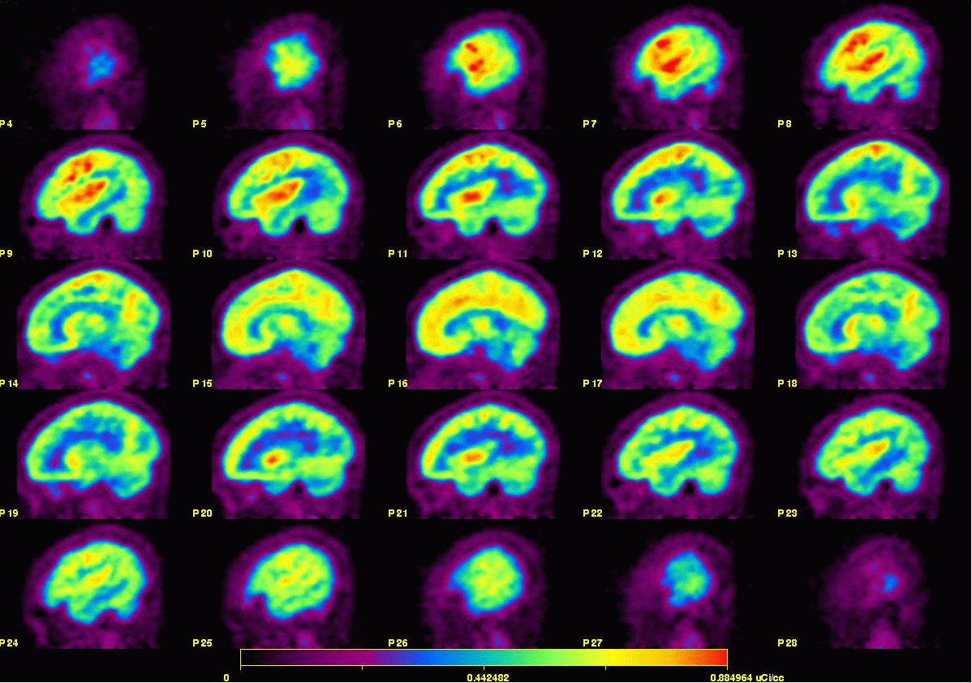
Linear Algebra: Medical Imaging

Slide 11
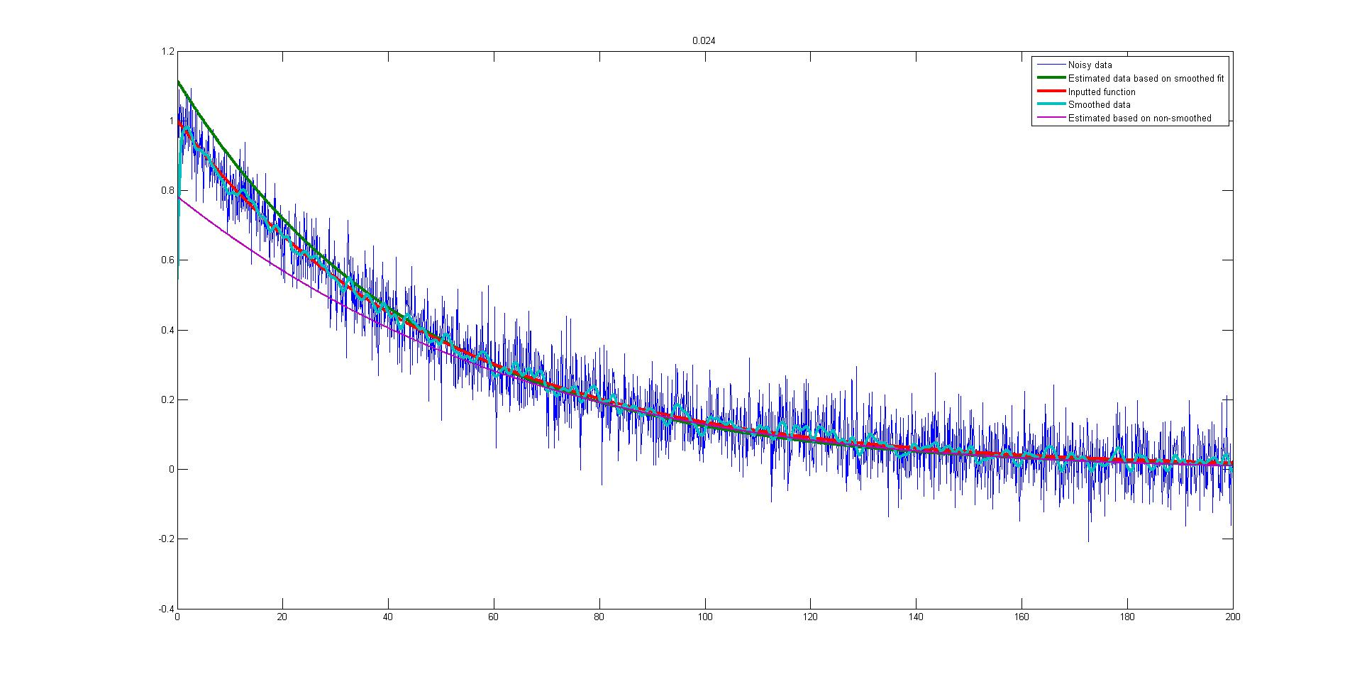
Linear Algebra: Data Fitting

Slide 12
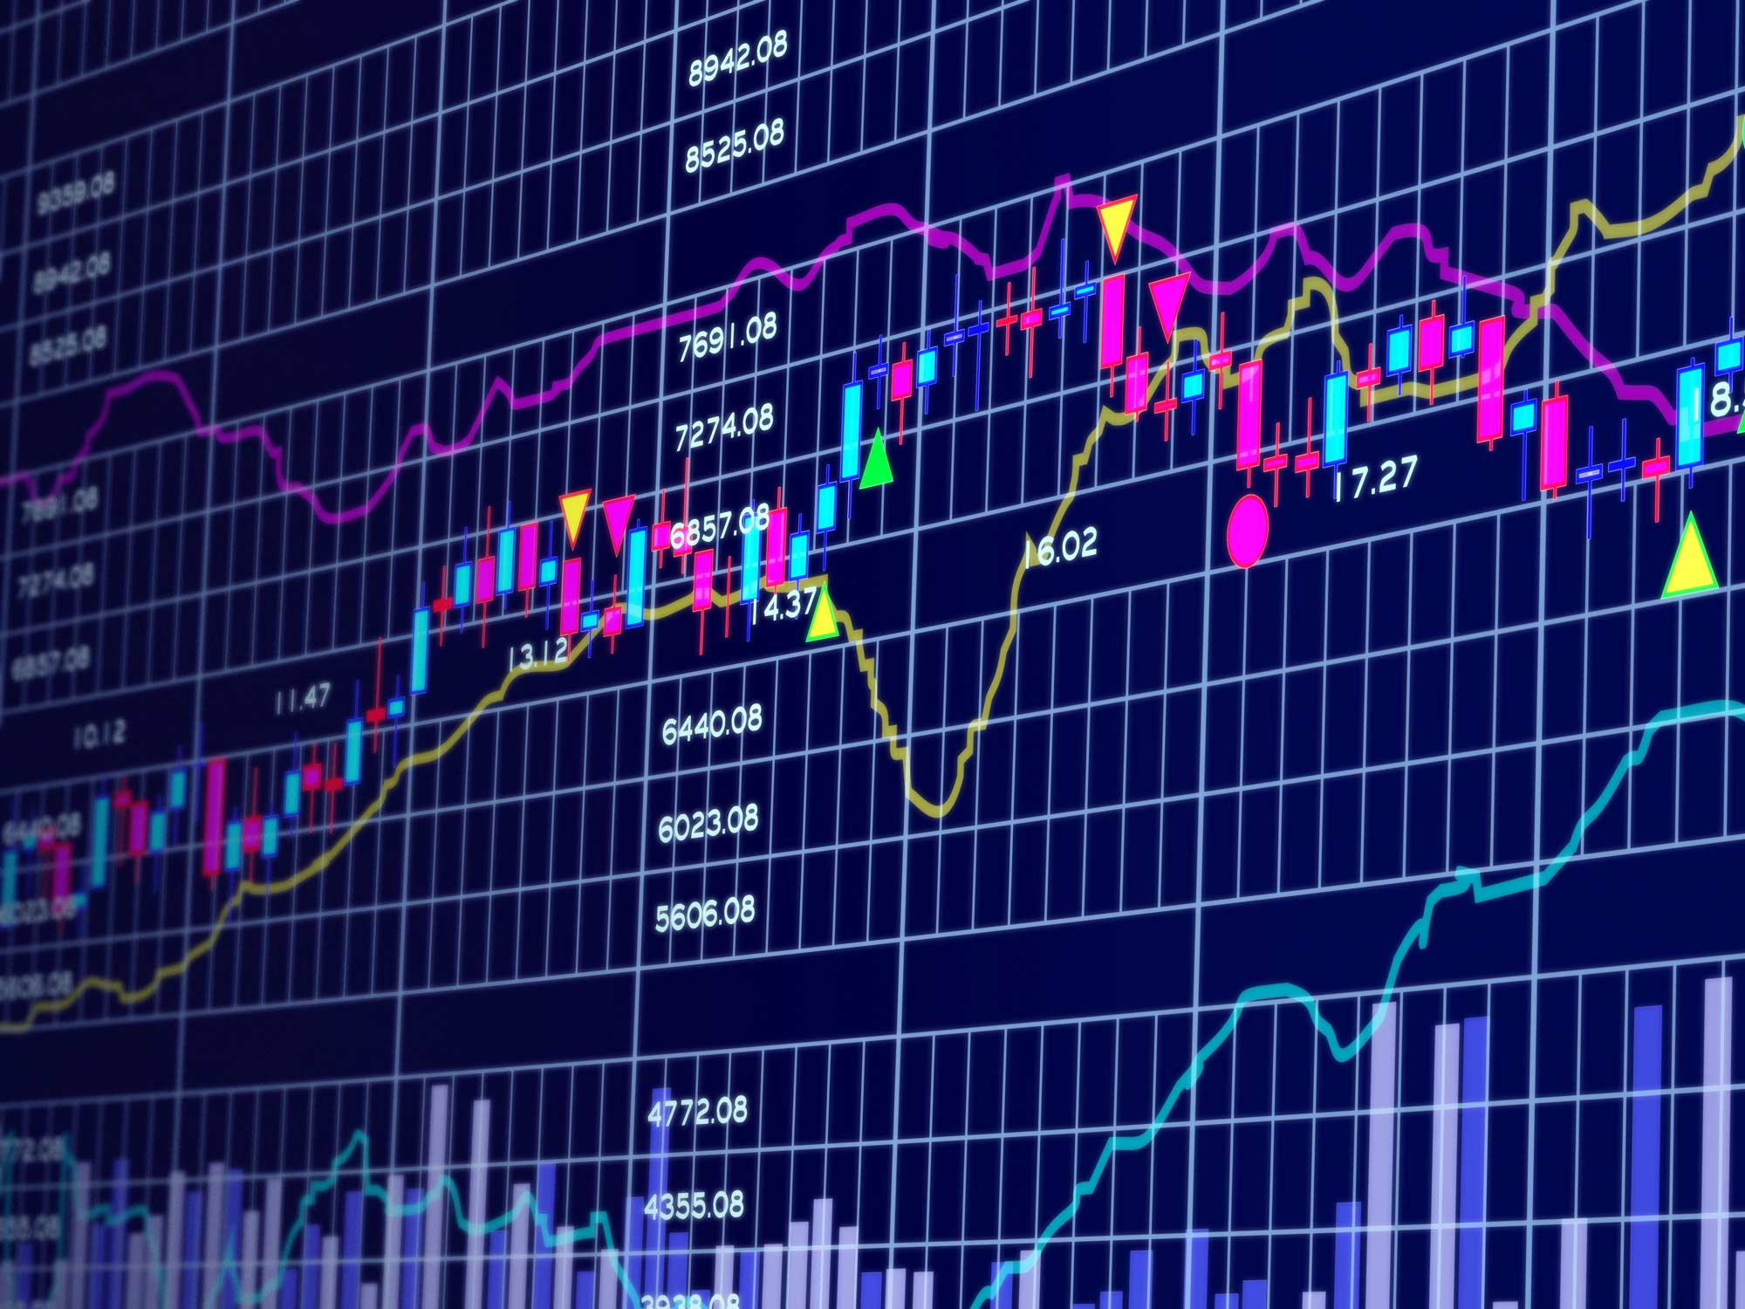
Linear Algebra: Finance

Slide 13
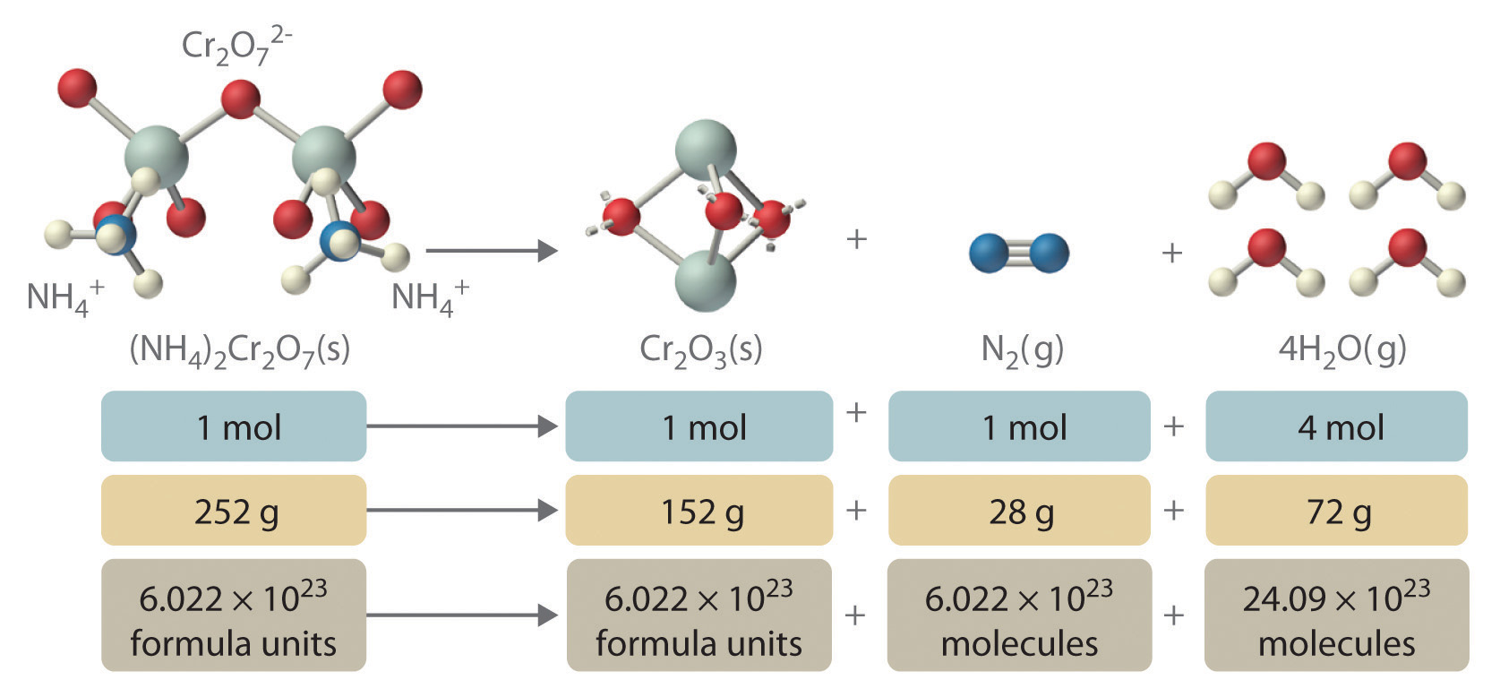
Linear Algebra: Chemistry

Slide 14
Linear Algebra: Digital Animation

Slide 15
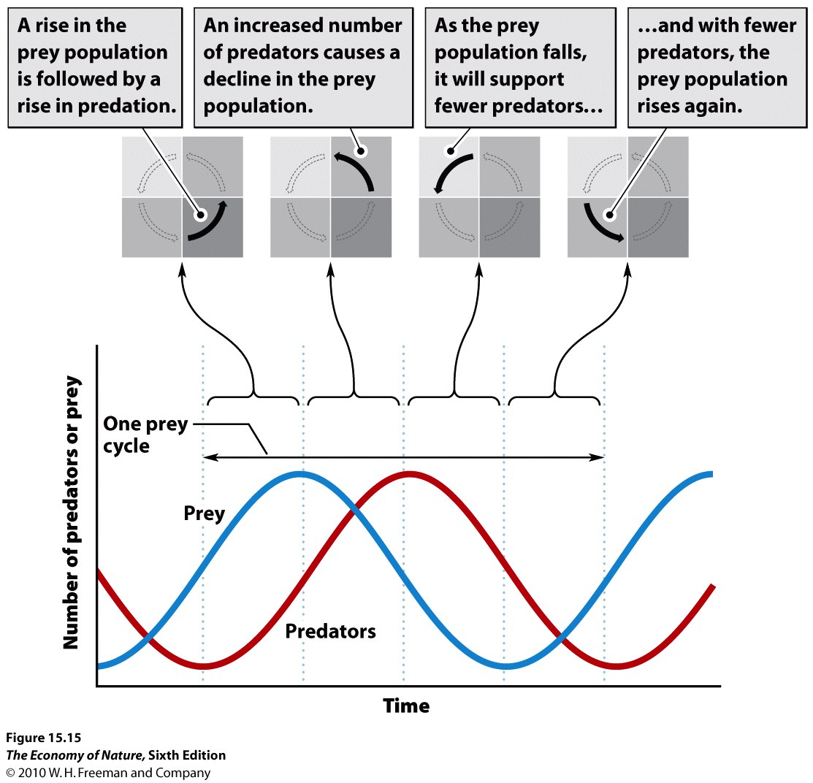
Linear Algebra: Predator/Prey Models

Slide 16
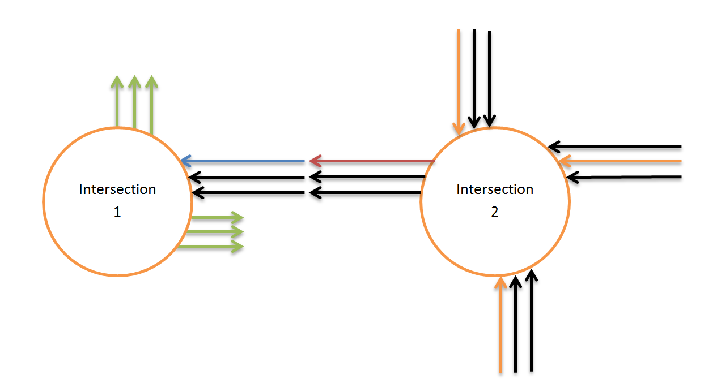
Linear Algebra: Traffic Flow
A few examples

Slide 17
Arc de Triomphe, Paris
maps.google.com
Notes:
Volume back up.

Slide 18
Arc de Triomphe, Paris
https://www.youtube.com/watch?v=yHTpcyoJdKI
Notes:
Volume back up.
So traffic at busy intersections can be pretty complicated and really slow everyone down, as we see in one view from atop the Arc de Triomphe in Paris.

Slide 19
Piazza del Colosseo, Rome
maps.google.com

Slide 20
Piazza del Colosseo, Rome
https://www.youtube.com/watch?v=rfn4s-3kJWE
Notes:
And in Rome, near the coliseum, we see that traffic flow is quite an complicated (and entertaining) issue.
It turns out that there are some mathematical ideas and theories underlying traffic flow.

Slide 21
A simple roundabout
Notes:
While the intersection shown here is not quite as interesting, it’s certainly easier to start with a simpler situation.

Slide 22
A simple roundabout
Notes:
We’re interested in the six entrances or exits shown.

Slide 23
A simple roundabout
Notes:
We’ll label those A through F.

Slide 24
A simple roundabout
Notes:
Suppose that we had the following flow in and out of this intersection (perhaps these numbers are cars per minute).

Slide 25
A simple roundabout
Notes:
We might be interested in what the traffic flows in each of the six regions of this roundabout.
We can label each of these unknown values x_1, x_2, and so on.
To figure out what each of these values, we can first write down simple expressions involving the various known and unknown values.

Slide 26
A simple roundabout
$$\begin{matrix}A & 60+x_{6} & = & { x}_{1} \\ B & x_{1} & = & x_{2}+70 \\ C & x_{2}+100 & = & x_{3} \\ D & x_{3} & = & x_{4}+90 \\ E & 80+x_{4} & = & x_{5} \\ F & x_{5} & = & 80+x_{6}\end{matrix}$$
Notes:
At point A, there are 60 plus whatever x_6 is going into the location at point A and x_1 exiting that point, which leads to the first equation, which is simply a relationship between one known and two unknown values.
We can do the same thing at points B through F.

Slide 27
A simple roundabout
$$\begin{matrix}A & 60+x_{6} & = & { x}_{1} \\ B & x_{1} & = & x_{2}+70 \\ C & x_{2}+100 & = & x_{3} \\ D & x_{3} & = & x_{4}+90 \\ E & 80+x_{4} & = & x_{5} \\ F & x_{5} & = & 80+x_{6}\end{matrix}$$

Slide 28
A simple roundabout
$$\begin{matrix}A & 60+x_{6} & = & { x}_{1} \\ B & x_{1} & = & x_{2}+70 \\ C & x_{2}+100 & = & x_{3} \\ D & x_{3} & = & x_{4}+90 \\ E & 80+x_{4} & = & x_{5} \\ F & x_{5} & = & 80+x_{6}\end{matrix}$$

Slide 29
A simple roundabout
$$\begin{matrix}A & 60+x_{6} & = & { x}_{1} \\ B & x_{1} & = & x_{2}+70 \\ C & x_{2}+100 & = & x_{3} \\ D & x_{3} & = & x_{4}+90 \\ E & 80+x_{4} & = & x_{5} \\ F & x_{5} & = & 80+x_{6}\end{matrix}$$

Slide 30
A simple roundabout
$$\begin{matrix}A & 60+x_{6} & = & { x}_{1} \\ B & x_{1} & = & x_{2}+70 \\ C & x_{2}+100 & = & x_{3} \\ D & x_{3} & = & x_{4}+90 \\ E & 80+x_{4} & = & x_{5} \\ F & x_{5} & = & 80+x_{6}\end{matrix}$$

Slide 31
A simple roundabout
$$\begin{matrix}A & 60+x_{6} & = & { x}_{1} \\ B & x_{1} & = & x_{2}+70 \\ C & x_{2}+100 & = & x_{3} \\ D & x_{3} & = & x_{4}+90 \\ E & 80+x_{4} & = & x_{5} \\ F & x_{5} & = & 80+x_{6}\end{matrix}$$

Slide 32
A simple roundabout
$$\begin{matrix}A & −x_{1}+x_{6} & = & −60 \\ B & x_{1}−x_{2} & = & 70 \\ C & x_{2}−x_{3} & = & −100 \\ D & x_{3}−x_{4} & = & 90 \\ E & x_{4}−x_{5} & = & −80 \\ F & x_{5}−x_{6} & = & 80 \end{matrix}$$
Notes:
We can rewrite these equations with all unknown values on the left hand side.

Slide 33
Six equations, six unknowns
$$\begin{matrix} −x_{1} +x_{6} & = & −60 \\ x_{1}−x_{2} & = & 70 \\ x_{2}−x_{3} & = & −100 \\ x_{3}−x_{4} & = & 90 \\ x_{4}−x_{5} & = & −80 \\ x_{5}−x_{6} & = & 80\end{matrix}$$
$$\begin{matrix}A & −x_{1}+x_{6} & = & −60 \\ B & x_{1}−x_{2} & = & 70 \\ C & x_{2}−x_{3} & = & −100 \\ D & x_{3}−x_{4} & = & 90 \\ E & x_{4}−x_{5} & = & −80 \\ F & x_{5}−x_{6} & = & 80 \end{matrix}$$
Notes:
Let’s write this in a more organized way.
(Click to animate.)

Slide 34
Matrix representation
$$\left[\begin{matrix}−1 & 0 & 0 & 0 & 0 & 1 \\ 1 & −1 & 0 & 0 & 0 & 0 \\ 0 & 1 & −1 & 0 & 0 & 0 \\ 0 & 0 & 1 & −1 & 0 & 0 \\ 0 & 0 & 0 & 1 & −1 & 0 \\ 0 & 0 & 0 & 0 & 1 & −1 \end{matrix}\right]\left[\begin{matrix}x_{1} \\ x_{2} \\ x_{3} \\ x_{4} \\ x_{5} \\ x_{6}\end{matrix}\right]=\left[\begin{matrix} −60 \\ 70 \\ −100 \\ 90 \\ −80 \\ 80\end{matrix}\right]$$
$$\begin{matrix} −x_{1} +x_{6} & = & −60 \\ x_{1}−x_{2} & = & 70 \\ x_{2}−x_{3} & = & −100 \\ x_{3}−x_{4} & = & 90 \\ x_{4}−x_{5} & = & −80 \\ x_{5}−x_{6} & = & 80\end{matrix}$$
Notes:
The matrix representation of these equations is given.
It turns out that matrices are a simple but very powerful tool in linear algebra.
We won’t go any further with matrices in today’s presentation, but when you take linear algebra, you’ll discover some very powerful uses of matrices. For today, we’ll simply note that the pattern of the matrix with 1’s and 0’s is expected, due to the traffic flow problem it came from, and that pattern is often useful to us in solving for the unknown values.

Slide 35
Questions and issues
$$\begin{matrix}A & −x_{1}+x_{6} & = & −60 \\ B & x_{1}−x_{2} & = & 70 \\ C & x_{2}−x_{3} & = & −100 \\ D & x_{3}−x_{4} & = & 90 \\ E & x_{4}−x_{5} & = & −80 \\ F & x_{5}−x_{6} & = & 80 \end{matrix}$$
Notes:
There are a number of interesting and important questions that arise in trying to understand and solve this problem.
Again, with today’s discussion being a short, introductory discussion, we won’t try to answer them right now.
But you might think about them as we move along.

Slide 36
Questions and issues
$$\begin{matrix}A & −x_{1}+x_{6} & = & −60 \\ B & x_{1}−x_{2} & = & 70 \\ C & x_{2}−x_{3} & = & −100 \\ D & x_{3}−x_{4} & = & 90 \\ E & x_{4}−x_{5} & = & −80 \\ F & x_{5}−x_{6} & = & 80 \end{matrix}$$
Is the fact that the number of equations (six) is equal to the number of unknowns significant?

Slide 37
Questions and issues
$$\begin{matrix}A & −x_{1}+x_{6} & = & −60 \\ B & x_{1}−x_{2} & = & 70 \\ C & x_{2}−x_{3} & = & −100 \\ D & x_{3}−x_{4} & = & 90 \\ E & x_{4}−x_{5} & = & −80 \\ F & x_{5}−x_{6} & = & 80 \end{matrix}$$
Is the fact that the number of equations (six) is equal to the number of unknowns significant?
What if the number of equations were different (more or less) than the number of unknowns?

Slide 38
Questions and issues
$$\begin{matrix}A & −x_{1}+x_{6} & = & −60 \\ B & x_{1}−x_{2} & = & 70 \\ C & x_{2}−x_{3} & = & −100 \\ D & x_{3}−x_{4} & = & 90 \\ E & x_{4}−x_{5} & = & −80 \\ F & x_{5}−x_{6} & = & 80 \end{matrix}$$
$$\left[\begin{matrix}−1 & 0 & 0 & 0 & 0 & 1 \\ 1 & −1 & 0 & 0 & 0 & 0 \\ 0 & 1 & −1 & 0 & 0 & 0 \\ 0 & 0 & 1 & −1 & 0 & 0 \\ 0 & 0 & 0 & 1 & −1 & 0 \\ 0 & 0 & 0 & 0 & 1 & −1 \end{matrix}\right]\left[\begin{matrix}x_{1} \\ x_{2} \\ x_{3} \\ x_{4} \\ x_{5} \\ x_{6}\end{matrix}\right]=\left[\begin{matrix} −60 \\ 70 \\ −100 \\ 90 \\ −80 \\ 80\end{matrix}\right]$$
Does the pattern/structure in the matrix help us or tell us anything about the problem and/or its solution?
Notes:
(Read question.)
Earlier we already point out that often the pattern or structure of a matrix is very useful to us in understanding the problem and finding its solution.

Slide 39
Questions and issues
$$\begin{matrix}A & −x_{1}+x_{6} & = & −60 \\ B & x_{1}−x_{2} & = & 70 \\ C & x_{2}−x_{3} & = & −100 \\ D & x_{3}−x_{4} & = & 90 \\ E & x_{4}−x_{5} & = & −80 \\ F & x_{5}−x_{6} & = & 80 \end{matrix}$$
Are all entrance/exit values (60, 80, etc.) valid/realistic, or is there a limited range of values for each of the entrance/exit values?
Notes:
(Read question.)
You might realize that we can’t have negative values for the unknown values x_1, x_2, and so on.

Slide 40
Questions and issues
$$\begin{matrix}A & −x_{1}+x_{6} & = & −60 \\ B & x_{1}−x_{2} & = & 70 \\ C & x_{2}−x_{3} & = & −100 \\ D & x_{3}−x_{4} & = & 90 \\ E & x_{4}−x_{5} & = & −80 \\ F & x_{5}−x_{6} & = & 80 \end{matrix}$$
Are all entrance/exit values (60, 80, etc.) valid/realistic, or is there a limited range of values for each of the entrance/exit values?
If so, is the range for each value related to the ranges for the other five?

Slide 41
Questions and issues
$$\begin{matrix}A & −x_{1}+x_{6} & = & −60 \\ B & x_{1}−x_{2} & = & 70 \\ C & x_{2}−x_{3} & = & −100 \\ D & x_{3}−x_{4} & = & 90 \\ E & x_{4}−x_{5} & = & −80 \\ F & x_{5}−x_{6} & = & 80 \end{matrix}$$
It turns out there is an infinite number of solutions to this problem. For example,
$\left(x_{1},x_{2},x_{3},x_{4},x_{5},x_{6}\right)=70, 0,100,10, 90,10$
$$\left(x_{1},x_{2},x_{3},x_{4},x_{5},x_{6}\right)=80,10,110,20,100,20$$
$$\left(x_{1},x_{2},x_{3},x_{4},x_{5},x_{6}\right)=90,20,120,30,110,30$$

Slide 42
Questions and issues
$$\begin{matrix}A & −x_{1}+x_{6} & = & −60 \\ B & x_{1}−x_{2} & = & 70 \\ C & x_{2}−x_{3} & = & −100 \\ D & x_{3}−x_{4} & = & 90 \\ E & x_{4}−x_{5} & = & −80 \\ F & x_{5}−x_{6} & = & 80 \end{matrix}$$
Is it significant that the difference between each pair of solutions is $10,10,10,10,10,10$?
Is the difference between any two solutions always $10,10,10,10,10,10$ ?
Notes:
(Read both questions.)
Or is the relationship between different solutions more flexible than this?

Slide 43
Questions and issues
$$\begin{matrix}A & −x_{1}+x_{6} & = & −60 \\ B & x_{1}−x_{2} & = & 70 \\ C & x_{2}−x_{3} & = & −100 \\ D & x_{3}−x_{4} & = & 90 \\ E & x_{4}−x_{5} & = & −80 \\ F & x_{5}−x_{6} & = & 80 \end{matrix}$$
Are there solutions that are mathematically possible but that don’t make sense in real life?
Notes:
(Read question.)
You would probably guess that the answer is yes, and you would be right.

Slide 44
Questions and issues
$$\begin{matrix}A & −x_{1}+x_{6} & = & −60 \\ B & x_{1}−x_{2} & = & 70 \\ C & x_{2}−x_{3} & = & −100 \\ D & x_{3}−x_{4} & = & 90 \\ E & x_{4}−x_{5} & = & −80 \\ F & x_{5}−x_{6} & = & 80 \end{matrix}$$
How would changing the value of one unknown, say $x_{3}$, affect the values of the other five?
Notes:
(Read question.)
It turns out that this is pretty easy to answer for this simple traffic flow question.
But the theory that we can develop, particularly if we look at the matrix representation of this problem, is very powerful and applicable to lots of other problems in which Linear Algebra is used.

Slide 45
Questions and issues
$$\begin{matrix}A & −x_{1}+x_{6} & = & −60 \\ B & x_{1}−x_{2} & = & 70 \\ C & x_{2}−x_{3} & = & −100 \\ D & x_{3}−x_{4} & = & 90 \\ E & x_{4}−x_{5} & = & −80 \\ F & x_{5}−x_{6} & = & 80 \end{matrix}$$
Is there any pattern or formula to the solutions?
Does this pattern help us answer some of the previous questions?

Slide 46
Questions and issues
$$\begin{matrix}A & −x_{1}+x_{6} & = & −60 \\ B & x_{1}−x_{2} & = & 70 \\ C & x_{2}−x_{3} & = & −100 \\ D & x_{3}−x_{4} & = & 90 \\ E & x_{4}−x_{5} & = & −80 \\ F & x_{5}−x_{6} & = & 80 \end{matrix}$$
Is there any pattern or formula to the solutions?
Is this pattern related to the pattern of the matrix?
Does this pattern help us answer some of the previous questions?

Slide 47
Questions and issues
$$\begin{matrix}A & −x_{1}+x_{6} & = & −60 \\ B & x_{1}−x_{2} & = & 70 \\ C & x_{2}−x_{3} & = & −100 \\ D & x_{3}−x_{4} & = & 90 \\ E & x_{4}−x_{5} & = & −80 \\ F & x_{5}−x_{6} & = & 80 \end{matrix}$$
Is there any pattern or formula to the solutions?
Is this pattern related to the pattern of the matrix?
Does this pattern help us answer some of the previous questions?
Notes:
(Read questions.)
It turns out that patterns and structure that we observe in problems is quite useful.
These patterns also are part of what mathematics such a beautiful endeavor.

Slide 48
Questions and issues
$$\begin{matrix}A & −x_{1}+x_{6} & = & −60 \\ B & x_{1}−x_{2} & = & 70 \\ C & x_{2}−x_{3} & = & −100 \\ D & x_{3}−x_{4} & = & 90 \\ E & x_{4}−x_{5} & = & −80 \\ F & x_{5}−x_{6} & = & 80 \end{matrix}$$
Do some (most? all?) of the questions and answers arising in this traffic flow problem arise in other applications in which Linear Algebra is used, say in medical imaging or balancing chemical equations?
Notes:
(Read questions.)
Much of the time in mathematics, we are interested in a particular problem, and in attempting to understand and solve that problem we develop some mathematical ideas and tools that we can use for this particular problem as well as for many other problems that arise in mathematics and science in general.

Slide 49
Questions and issues
$$\begin{matrix}A & −x_{1}+x_{6} & = & −60 \\ B & x_{1}−x_{2} & = & 70 \\ C & x_{2}−x_{3} & = & −100 \\ D & x_{3}−x_{4} & = & 90 \\ E & x_{4}−x_{5} & = & −80 \\ F & x_{5}−x_{6} & = & 80 \end{matrix}$$
How does our understanding of the problem and its solutions help us understand the real issues of traffic flow at this intersection so that we can avoid traffic congestion and optimize traffic flow?
Notes:
(Read questions.)
Of course ultimately one of the main reasons we do mathematics is to solve the problems in which the mathematics arises.
In this case, we want to better understand the traffic flow at this intersection.

Slide 50
More details on this presentation
I’m putting together a spreadsheet for this intersection which would allow students to experiment with other entrance/exit values and corresponding solutions.
Students could think about other types of intersections and make conjectures and try to come up with answers for their own questions.
The goal is to get them interested and involved.

Slide 51
More details on this presentation
I’m also going to include the basic Linear Algebra ideas that arise in two or three other applications.
Obviously there is much more to Linear Algebra than we can attempt to show in a simple presentation like this. We don’t want to overwhelm students with ideas that don’t normally show up until two or three months in. We want to pique their interest.

Slide 52
This and other presentations
I’m planning to have an AV specialist (perhaps someone familiar with doing animation, film, etc.) help improve the use of color, animation, music, flow and overall presentation.
The goal is to create a presentation that is interesting, entertaining and even captivating, like a good film.

Slide 53
Questions?

