Slide 1
Systems of Equations as Matrices and Hill Cipher.
Annela Kelly
Bridgewater State University

Slide 2
Matrix multiplication review applet at: https://www.khanacademy.org/math/algebra2/alg2-matrices/matrix-multiplication-alg2/e/multiplying_a_matrix_by_a_matrix or http://www.mathsisfun.com/algebra/matrix-multiplying.html
Matrix Algebra
Algebra
ax=b
5x=3
x= $\frac{3}{5}$ = $5^{−1}$ 3
Ax=b
$\left[\begin{matrix}5 & 0 \\ 2 & 1\end{matrix}\right]\left[\begin{matrix}x_{1} \\ x_{2}\end{matrix}\right]=\left[\begin{matrix}3 \\ 4\end{matrix}\right]$
$\left[\begin{matrix}x_{1} \\ x_{2}\end{matrix}\right]={\left[\begin{matrix}5 & 0 \\ 2 & 1\end{matrix}\right]}^{−1}\left[\begin{matrix}3 \\ 4\end{matrix}\right]$
What is ${\left[\begin{matrix}5 & 0 \\ 2 & 1\end{matrix}\right]}^{−1}$ ?

Slide 3
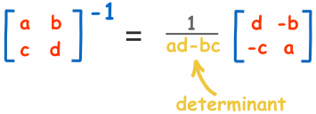
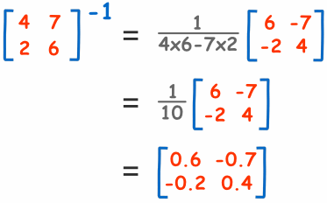
Matrix inverse formula ${ A A}^{−1}=\left[\begin{matrix}1 & 0 \\ 0 & 1\end{matrix}\right]$
Matrix inverse for 2× 2matrix:
EXAMPLE:
To get more details and in-depth discussion about inverses:
http://www.mathsisfun.com/algebra/matrix-inverse.html

Slide 4
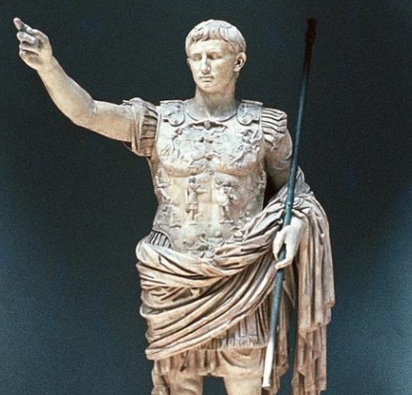
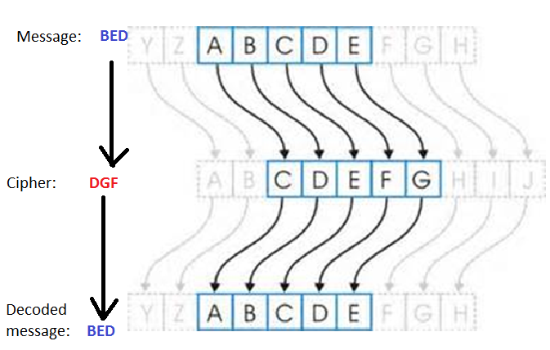
Cryptology
Caesar Cipher (100 BC)

Slide 5
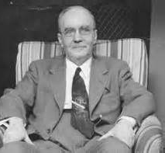
Hill cipher
As time progressed, the study of cryptography began to involve higher level mathematics. With this more advanced math came more advanced ciphers based on the idea of encryption and decryption keys.
Encryption keys are a special value or set of values used in an encryption algorithm to convert a plaintext into a cipher text.
A decryption key is the opposite.
One encryption scheme that utilizes more advanced mathematics, as well as encryption and decryption keys is a cipher from 1929 called the Hill cipher.
The Hill cipher is based on matrix multiplication and is a lot more secure than the Caesar cipher that
was previously discussed.

Slide 6
Numbers into letters
Example: BED
1 4 3

Slide 7
Modular Calculations
What if a number is bigger than 26 or smaller than 0?
Use “clock arithmetic”:
12 ≡ 12
27 ≡ 1
-1 ≡ 25
53 ≡ 1
Worksheet on clock arithmetic!

Slide 8
(Matrix) inverses formula modulo 26
Algebra
5 ∙6=30
5 ∙21=105
5∙$\frac{1}{5}$=1 i.e. $5^{−1}$=$\frac{1}{5}$
Modulo 26 Algebra
5 ∙6 ≡ 4
5 ∙21 ≡ 1
$5^{−1}\text{≡}$ 21
Worksheet on inverses mod 26!

Slide 9
Encoding in Hill Cipher
Convert letters into numbers
Write message into blocks (matrices) of two
Multiply decoding matrix A with the vectors
Convert numbers into letters

Slide 10
Decoding in Hill Cipher
Convert numbers into letters:
Multiply decoding matrix $A^{−1}$ with the vectors:
Convert numbers into letters
Worksheet on encoding and decoding!

Slide 11
Exchanging secrets
MESSAGE: CALCULUS
$\left[\begin{matrix}2 & −1 \\ 3 & 4\end{matrix}\right]$
CODE: EGUPDAWC
-1
$\left[\begin{matrix}2 & −1 \\ 3 & 4\end{matrix}\right]$
DECODED MESSAGE: CALCULUS
More info on Hill Ciphers at:
http://www.unc.edu/~marzuola/Math547_S13/Math547_S13_Projects/R_Doyle_Section001_Cryptography.pdf

