Slide 1
Catholic Teaching and
Consumer Culture
Andy Yuengert
The University
March 10, 2009

Slide 2
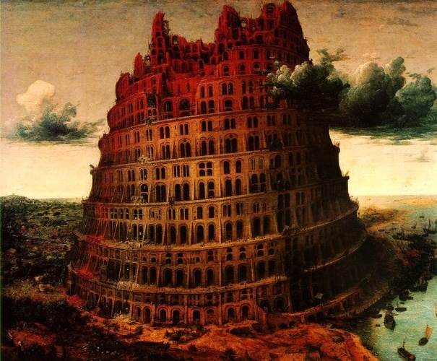



Back to the Basics!
Notes:
Economic hard times
rethink priorities
rethink our lives
look back on our behavior, our choices
Buildings, debt, things driving decisions about family, location decisions, work decisions
Refocus: Faith family friends

Slide 3
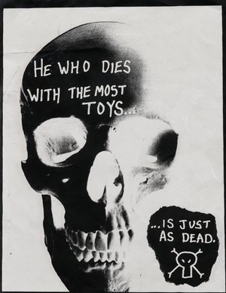
The Problem: Consumerism
In his riches man lacks wisdom: he is like the beasts that are destroyed.
- Psalm 49:13
Notes:
Purpose of this talk is to get a Catholic perspective on consumerism
What is consumerism?
Rich, but spiritually empty, purposeless
Do we really need to die rich?
Why do material riches sometimes lead to spiritual poverty?
How can we tell if we are falling into this trap?

Slide 4
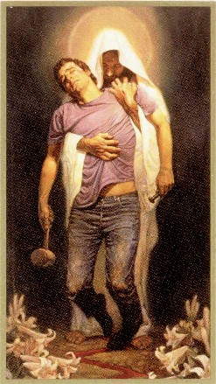
I’m No Angel!
Notes:
Before we go on
I am as likely as any of you to fall into this sin.
I’m no angel
I’m talking about myself – at least someone in the room needs to hear
this – me!

Slide 5
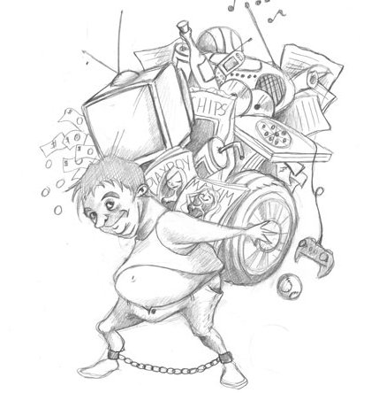

The Question
How Much is Too Much?
Is it Bad to Want More?
Notes:
God has called most of us to lives in the world – working, providing for ourselves and others.
We can’t avoid this
We can’t give ourselves easy excuses, either
So, our question is
God wants us to provide for our needs,
How much is too much
Is it bad to want more?
notice, the things on this slide are not bad things in themselves.

Slide 6
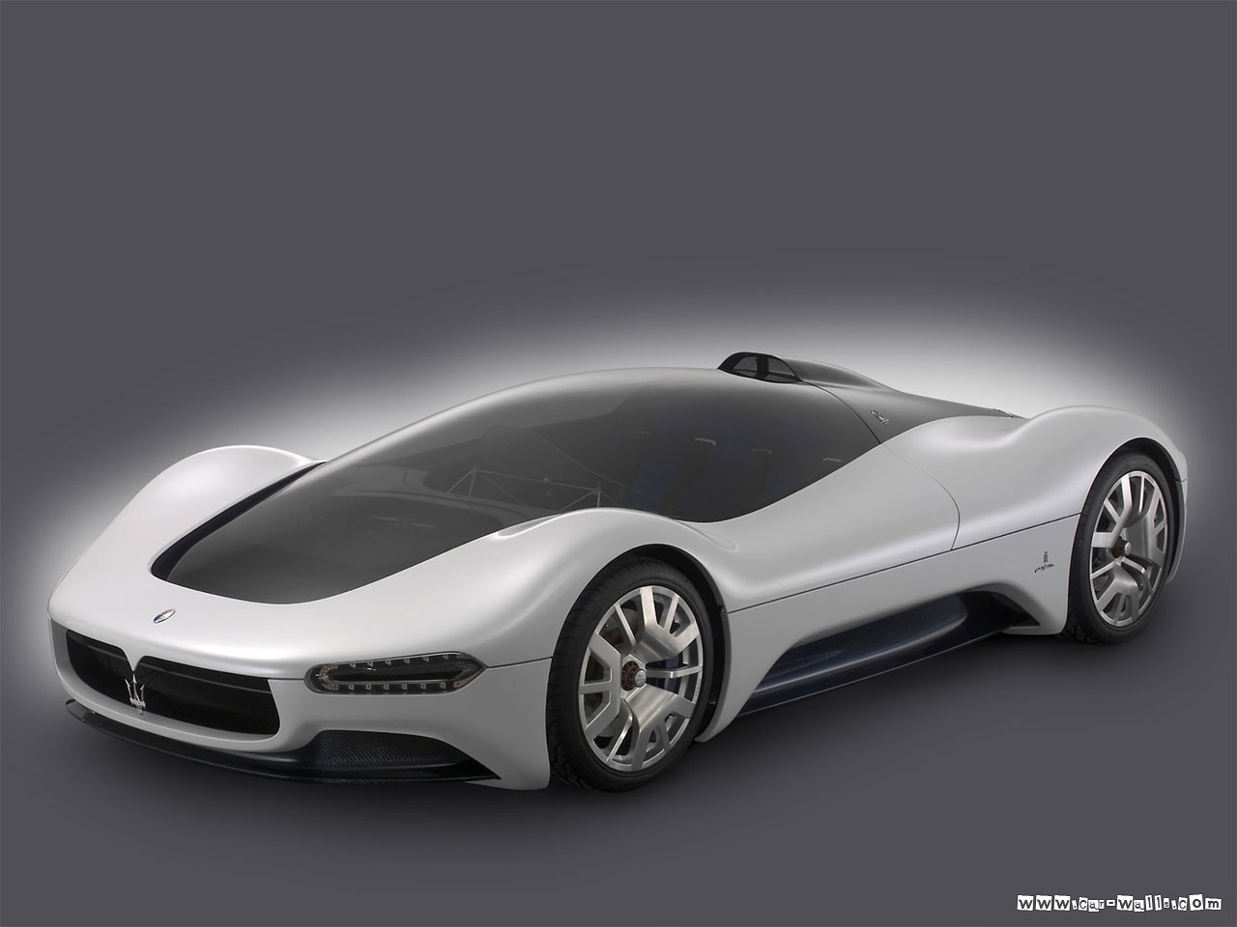
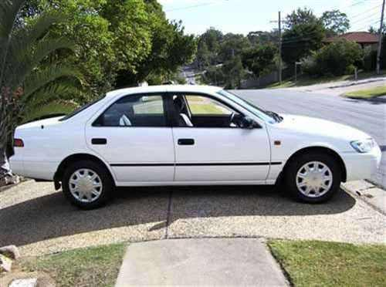
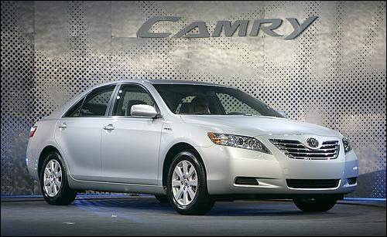
We Aren’t So Bad, Really!
Notes:
But wait a minute? We aren’t exactly living the lifestyles of the rich and famous
Our question is not: should I buy the mazerati?

Slide 7
We Aren’t So Bad, Really!
Notes:
Our question is usually something like this:
Should I buy a used car or a new car?
What could be wrong with wanting a new car?
How can we know?

Slide 8
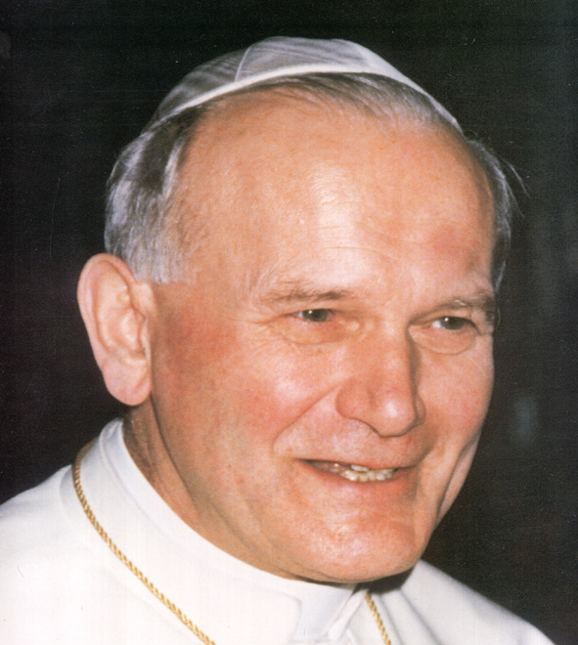
Goods Out of Order!
‘Having’ vs ’Being’
  – John Paul II
Notes:
Let’s start with JPII, who addressed the problem of consumerism several times in his writings
CA: “It is not wrong to want to live better; what is wrong is a style of life which is presumed to be better when it is directed towards "having" rather than "being", and which wants to have more, not in order to be more but in order to spend life in enjoyment as an end in itself.”
“Enjoyment as an end in itself” What are goods really for? A lack of perspective.
“How much is too much” is the wrong question. The right question is “What are good s for? If “not as an end in itself”, then what for?

Slide 9
Goods Out of Order!
‘Having’ vs ’Being’
‘Super-development’
‘Slaves of possession’
  – John Paul II
Notes:
SRS:
“This super-development, which consists in an excessive availability of every kind of material goods, easily makes people slaves of "possession" and of immediate gratification, with no other horizon than the multiplication or continual replacement of the things already owned with others still better. “
No other horizon than multiplication of goods!
Horizon is a background, a perspective.
Problem of materialism is the root problem:
Living as if God did not exist.
If we needed any evidence that consumerism is a problem, JPII offers three pieces of evidence

Slide 10
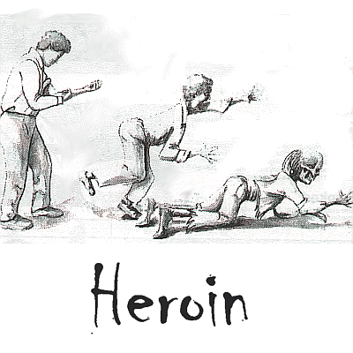
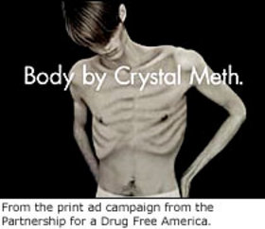
JPII: Evidence of Consumerism
Drug Addiction
Notes:
Sign of materialism – people who have forgotten that their lives are more than their appetites, and others who will sell people anything.
“Drugs, as well as pornography and other forms of consumerism which exploit the frailty of the weak, tend to fill the resulting spiritual void.”

Slide 11

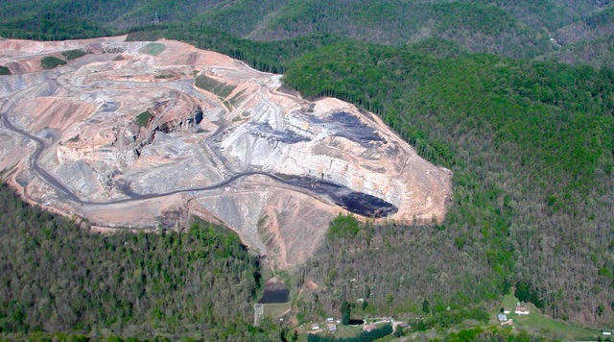
JPII: Evidence of Consumerism
Abuse of the Environment
Notes:
In his desire to have and to enjoy rather than to be and to grow, man consumes the resources of the earth and his own life in an excessive and disordered way.
“Senseless desctuction”
Forgetting the purpose of the earth
Setting ourselves up in the place of God.

Slide 12
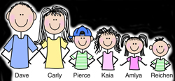
JPII: Evidence of Consumerism
The worst effect: the Decline of the family
Notes:
JPII’s most important piece of evidence: “destruction of the human environment”
The family

Slide 13
JPII: Evidence of Consumerism
The worst effect: the Decline of the family
  Life a series of sensations
  Lack of freedom to marry
  Lack of generosity in having children
Notes:
But it often happens that people are discouraged from creating the proper conditions for human reproduction and are led to consider themselves and their lives as a series of sensations to be experienced rather than as a work to be accomplished. The result is a lack of freedom, which causes a person to reject a commitment to enter into a stable relationship with another person and to bring children into the world, or which leads people to consider children as one of the many "things" which an individual can have or not have, according to taste, and which compete with other possibilities.

Slide 14
Perspective: Are We Rich?
Notes:
All of this would be less of a problem if we lived in a poor country.
We forget just how rich we are. This chart can give you some perspective.
Poverty line for a family of four in 2000: 17,463 dollars
That doesn’t seem like much, does it. And it’s not.
Eleven % of households lived on less than that in 2000.
But what would it have been like to live on that much one hundred years ago? It would have put you in the top 10% of earners.
Our poor would have been rich one hundred years ago.

Slide 15
Perspective: Are We Rich?
Notes:
How does our poor compare to the rest of the world. What would it be like to have !7463 dollars in other countries?
This chart shows the average incomes of all the countries in the world.
There are 124 countries in the world where $17463 is above average. These countries include India and China, the two most populous countries in the world.
If our poor are well off compared to people 100 years ago, and relative to much of the world today, what should we say about ourselves.
How sorry should we feel when we cannot have more goods?
We are rich, by any standard. I’m talking about everyone in this room.

Slide 16
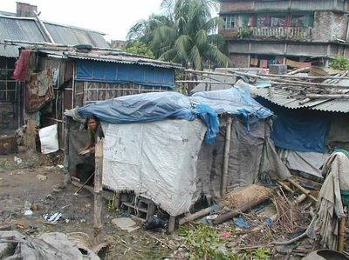
Perspective: Are We Rich?
The World’s Poor
Notes:
Here are the poor of the world. In its slums, without running water or sanitation, scavenging garbage for food.
Almost everyone else in the world looks at my beat up old car, or my beat up shoes that need replaced, and says ”Rich”
We are wildly rich, why don’t we feel that way?

Slide 17
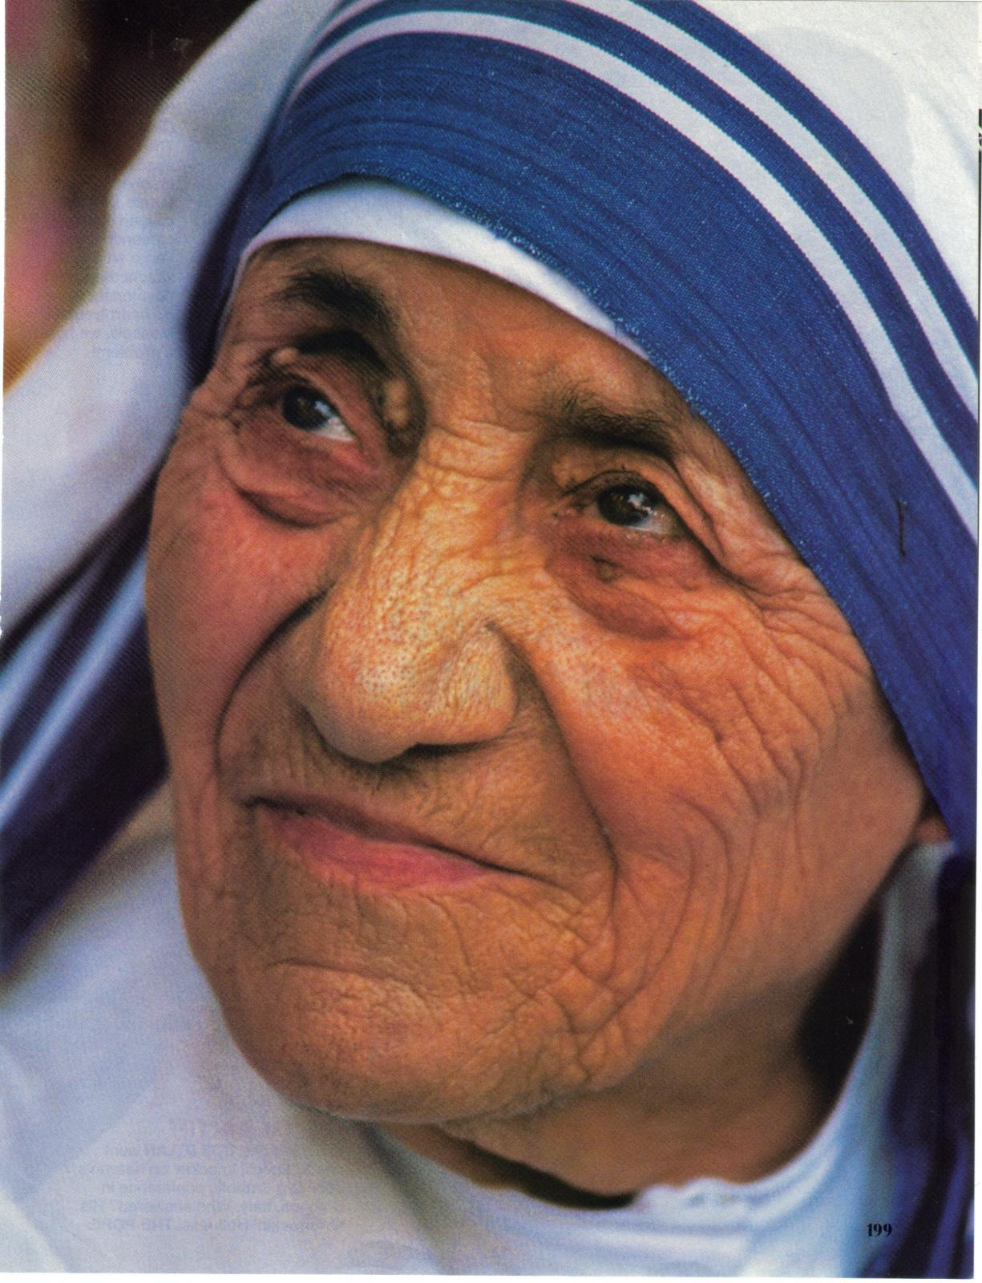
“I think people are so preoccupied with material difficulties. In the industrial world where people are supposed to have so much, I find that many people, while dressed up, are really poor.”
Mother Teresa
Notes:
Mother Teresa always noted the poverty and sadness of people in rich countries. Our material riches seemed to lead to spiritual poverty.

Slide 18
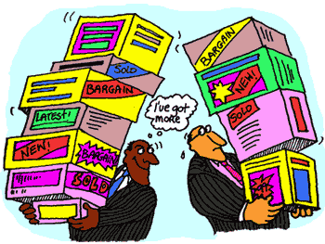
Relative Income Comparisons
Letting Neighbors Set Your Standards
Notes:
Some of this may be due to the fact that we measure ourselves, see how we are doing, by looking around us, and seeing what others have.
This guy has a lot, but he feels poor.

Slide 19
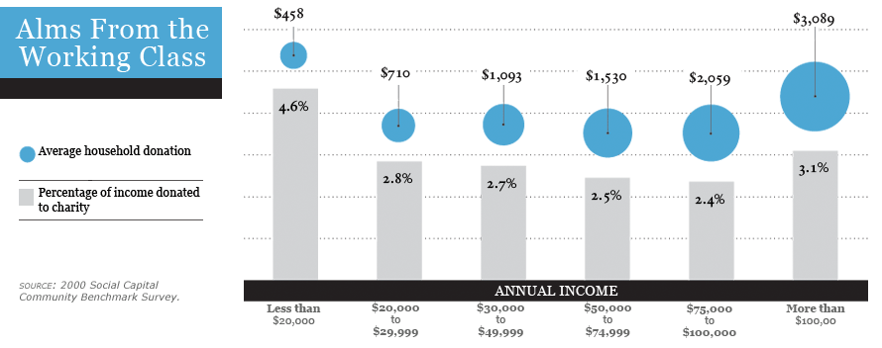
The Poor Shame Us All
Notes:
The problem is so bad that in the United States the poor give more money as a % of their income than everyone else .
#s It’s worse than it looks, because these are averages. Many people give less than 1%, and some give 10% or more.
Something is wrong, if we don’t see people becoming more generous as their income rises.

Slide 20
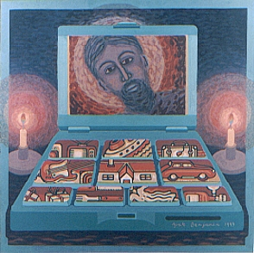
What We Need: Catholic Context
What is
Wealth For?
The Dangers
of Wealth
Keeping Wealth
in Perspective
Notes:
So we’ve seen the symptoms of the problem:
People caught up in consuming
- less generous
-financially
- in the family
- with time
- in having children
It seems that material goods have gotten over hand, and are dominating us
We need context, Catholic context

Slide 21
What is Wealth For?
Who Made
Wealth?
Why?
Notes:
If we ant to know the right attitude toward wealth, we should ask why God made it, and us. We need to go back to the beginning
Genesis 1-3 so important

Slide 22
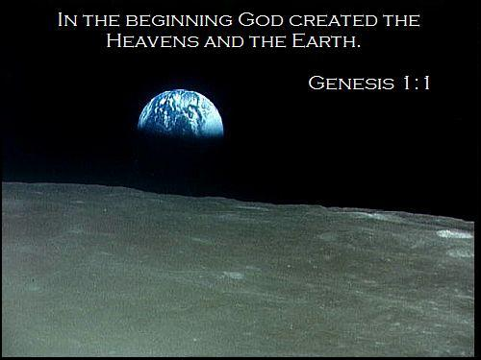
What is Wealth For?
Who Made
Wealth?
Why?
Notes:
God made heaven and earth
God made every material thing
Shouldn’t we want to know why?

Slide 23
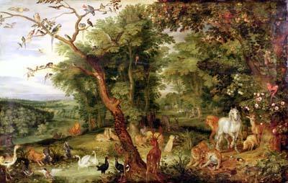
What is Wealth For?
“God Planted a Garden …. (Genesis 2)
For Who?
For Us!
Notes:
For us!

Slide 24
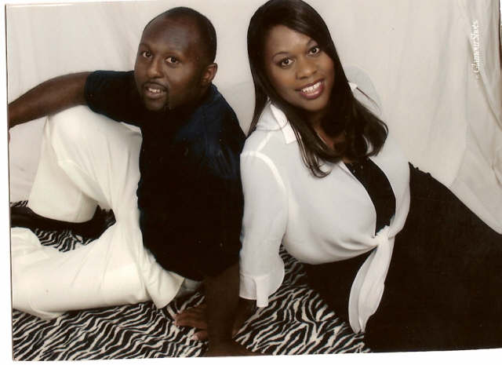
What is Wealth For?
God Created man in His Own image; In the Image of God He Created him; Male and Female He Created Them (Genesis 1: 26-28)
Notes:
In the image of God
crucial phrase
At the pinnacle of creation
Male and Female
in community right away

Slide 25
What is Wealth For?
“Be fertile and multiply; fill the earth and subdue it. Have dominion over the fish of the sea, the birds of the air, and all the living things that move on the earth.” God also said: "See, I give you every seed-bearing plant all over the earth and every tree that has seed-bearing fruit on it to be your food; and to all the animals of the land, all the birds of the air, and all the living creatures that crawl on the ground, I give all the green plants for food.” And so it happened. God looked at everything he had made, and he found it very good.
Genesis 1:28-31
Notes:
Have dominion
gives the earth for our nourishment, benefit
- it’s all good!
Created goods are good!

Slide 26
What is Wealth For?
Then the LORD God planted a garden in Eden, in the east, and he placed there the man whom he had formed.
- Genesis 2: 8
The LORD God then took the man and settled him in the garden of Eden, to cultivate and care for it.
- Genesis 2:15
Notes:
Plants a garden, we tend it.
Provides us with a living – a world to meet our needs

Slide 27
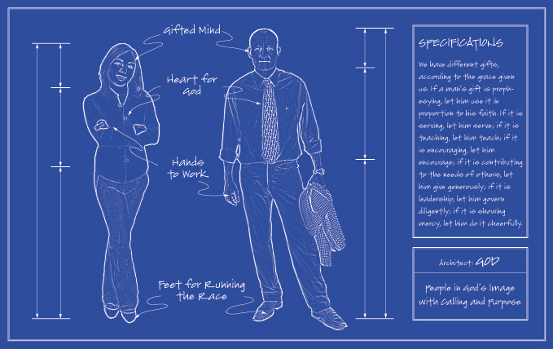
What is Wealth For?
  Why Did God Make Us?
  Have Dominion
  Tend the Garden
  Eat of the Fruit
  Br Fruitful and Multiply
  Creation meets our needs, and we work it.
Notes:
summarize

Slide 28

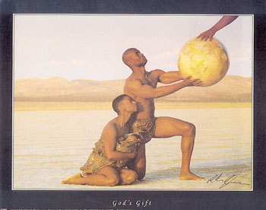
What is Wealth For?
The Material World is a Gift
What Kind of Gift?
  Santa Claus?
  Given and Forgotten?
  No! A Gift in a Relationship
    God The Father
    Settles us in Garden
    Visits
    Limits to use

Slide 29
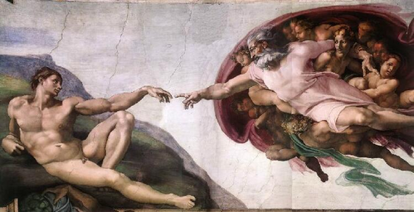
What is Wealth For?
Material Goods are Good Gifts
Understood only in Relation to the Giver
Notes:
Can’t understand a gift without knowing something about the giver
Ex. A really nice necklace, or something very touching, like a scrapbook of memories
- must be a very special person.
- to fully understand the gift, must understand the giver, the
relationship
Ex. Someone has a nice watch
It was a gift
From who?
I don’t know
What is missing?

Slide 30
Danger! The Fall
Notes:
Not enough to know that creation is good, and was given as a gift and a task to us.
We are fallen

Slide 31
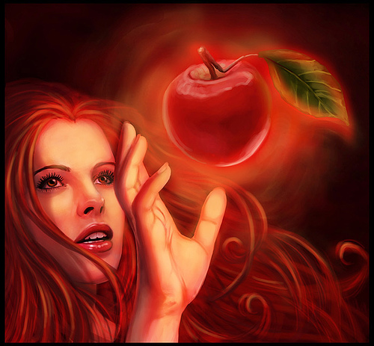
Danger! The Fall
The woman saw that the tree was good for food, pleasing to the eyes, and desirable for gaining wisdom. So she took some of its fruit and ate it; and she also gave some to her husband, who was with her, and he ate it.
Genesis 3: 6
Notes:
What did Eve do
Saw that apple was “good to eat”
not that it was a gift, with constraints
fruit out of context
Out of order
What is the fruit for
Keeping God in the picture

Slide 32
Right
Order
God
Family
Charity
Church
Needs
Fun
Riches
Notes:
Higher up, with arrows leading to it, more important reasons
Everything for God
Ultimate good
Everything comes from him, goes back to him

Slide 33
Wrong
Order
Riches
Needs
Fun
Family
Church
God
Notes:
This is obviously the wrong order
“Inversions of Means and ends
Leads to slavery, unhappiness

Slide 34
Wrong
Order
God
Needs
Fun
Family
Church
Riches
Notes:
What’s wrong with this

Slide 35
Wrong
Order
God
These are Gifts Too!
Needs
Fun
Family
Church
Riches
Notes:
Like most of us
separate lives, separate priorities
God on Sunday, before meals
not at work, play
We are one person, not two or three or four
If these don’t get placed in context, they will become too important
How can we know if they aren’t part of the picture

Slide 36
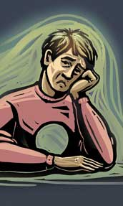
Fails to Satisfy: Haggai 1:6
You have sown much, but have brought in little; you have eaten, but have not been satisfied; You have drunk, but have not been exhilarated; have clothed yourselves, but not been warmed; And he who earned wages earned them for a bag with holes in it.
Notes:
Bible. Not exhaustive treatment, but some examples. Lots of gems like this, from the prophet Haggai:

Slide 37
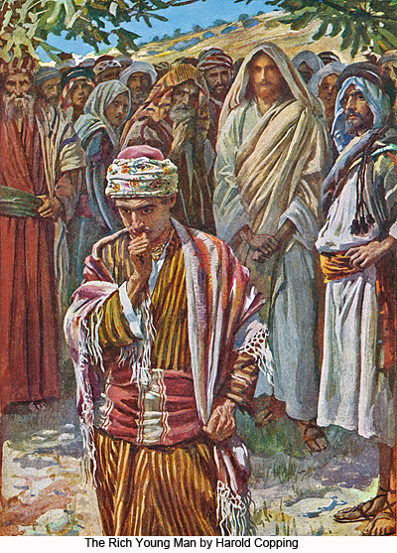
Rich Young Man (Luke 18)
How hard it is for those who have wealth to enter the kingdom of God!
The Apostle who Said No?
Notes:
¹⁸A certain ruler asked him, "Good teacher, what must I do to inherit eternal life?" ¹⁹"Why do you call me good?" Jesus answered. "No one is good—except God alone. ²⁰You know the commandments: 'Do not commit adultery, do not murder, do not steal, do not give false testimony, honor your father and mother.'^{[b]}"
²¹"All these I have kept since I was a boy," he said. ²²When Jesus heard this, he said to him, "You still lack one thing. Sell everything you have and give to the poor, and you will have treasure in heaven. Then come, follow me.“ ²³When he heard this, he became very sad, because he was a man of great wealth. ²⁴Jesus looked at him and said, "How hard it is for the rich to enter the kingdom of God! ²⁵Indeed, it is easier for a camel to go through the eye of a needle than for a rich man to enter the kingdom of God.“ ²⁶Those who heard this asked, "Who then can be saved?“ ²⁷Jesus replied, "What is impossible with men is possible with God.“ ²⁸Peter said to him, "We have left all we had to follow you!“ ²⁹"I tell you the truth," Jesus said to them, "no one who has left home or wife or brothers or parents or children for the sake of the kingdom of God ³⁰will fail to receive many times as much in this age and, in the age to come, eternal life."
A good man, follows the law
Rejects Christ’s invitation! For what? Was it worth it.
Goes away sad! Still, does not choose Christ.
What would you have done? Easy to think we would. The stakes are very high
No loss from giving up all for Christ

Slide 38
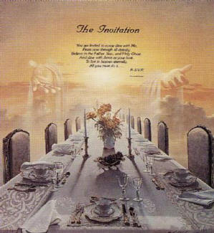
The Banquet (Luke 14: 15-20)
Good Excuses for Missing God’s Feast?
“I have purchased a field and must go to examine it.”
“I have purchased five yoke of oxen and am on my way to evaluate them.”
“I have just married a woman.”
Notes:
¹⁵When one of those at the table with him heard this, he said to Jesus, "Blessed is the man who will eat at the feast in the kingdom of God." ¹⁶Jesus replied: "A certain man was preparing a great banquet and invited many guests. ¹⁷At the time of the banquet he sent his servant to tell those who had been invited, 'Come, for everything is now ready.‘ ¹⁸"But they all alike began to make excuses. The first said, 'I have just bought a field, and I must go and see it. Please excuse me.‘ ¹⁹"Another said, 'I have just bought five yoke of oxen, and I'm on my way to try them out. Please excuse me.'
²⁰"Still another said, 'I just got married, so I can't come.‘ ²¹"The servant came back and reported this to his master. Then the owner of the house became angry and ordered his servant, 'Go out quickly into the streets and alleys of the town and bring in the poor, the crippled, the blind and the lame.‘ ²²" 'Sir,' the servant said, 'what you ordered has been done, but there is still room.'
We all want to go to heaven, to the feast
These are all good excuses, but not good excuses to miss God’s feast.
good only in perspective
Jesus experienced these things keeping people from the kingdom of God, from relationship with him. Remember the rich young man.
-there is lots of room

Slide 39
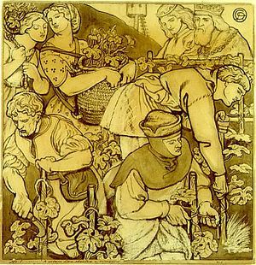
The Master’s Vineyard (MT. 21)
It’s God’s World!
“When vintage time drew near, he sent his servants to the tenants to obtain his produce. But the tenants seized the servants and one they beat, another they killed, and a third they stoned.”
Notes:
³³"Listen to another parable: There was a landowner who planted a vineyard. He put a wall around it, dug a winepress in it and built a watchtower. Then he rented the vineyard to some farmers and went away on a journey. ³⁴When the harvest time approached, he sent his servants to the tenants to collect his fruit.
^{- Collect HIS FRUIT!}
³⁵"The tenants seized his servants; they beat one, killed another, and stoned a third. ³⁶Then he sent other servants to them, more than the first time, and the tenants treated them the same way. ³⁷Last of all, he sent his son to them. 'They will respect my son,' he said. ³⁸"But when the tenants saw the son, they said to each other, 'This is the heir. Come, let's kill him and take his inheritance.' ³⁹So they took him and threw him out of the vineyard and killed him. ⁴⁰"Therefore, when the owner of the vineyard comes, what will he do to those tenants?“ ⁴¹"He will bring those wretches to a wretched end," they replied, "and he will rent the vineyard to other tenants, who will give him his share of the crop at harvest time."

Slide 40
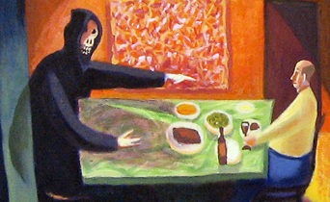
Rich Fool (Luke 12)
“This is how it will be with anyone who stores up things for himself but is not rich toward God.”
Notes:
¹⁵Then he said to them, "Watch out! Be on your guard against all kinds of greed; a man's life does not consist in the abundance of his possessions."
¹⁶And he told them this parable: "The ground of a certain rich man produced a good crop. ¹⁷He thought to himself, 'What shall I do? I have no place to store my crops.'
¹⁸"Then he said, 'This is what I'll do. I will tear down my barns and build bigger ones, and there I will store all my grain and my goods. ¹⁹And I'll say to myself, "You have plenty of good things laid up for many years. Take life easy; eat, drink and be merry." '
²⁰"But God said to him, 'You fool! This very night your life will be demanded from you. Then who will get what you have prepared for yourself?'
²¹"This is how it will be with anyone who stores up things for himself but is not rich toward God.“
What does it mean to be rich toward God?

Slide 41

Clueless in Riches: Amos 5:18
Woe to those who yearn for the day of the LORD! What will this day of the LORD mean for you? Darkness and not light!
Notes:
Kingdom of Israel
- time of prosperity, success
- made use of prosperity to offend God, forget him
-injustice, evading laws of God
Still, yearning for the day of the Lord! Unaware that God was coming to judge them!
Blind.
Important point about human beings. Even when we turn from God, we rationalize out behavior, and can even convince ourselves that we are pleasing God.
Don’t just shake your head about those silly Israelites. God did not put this in Scripture for kicks, he meant it to be a lesson.

Slide 42
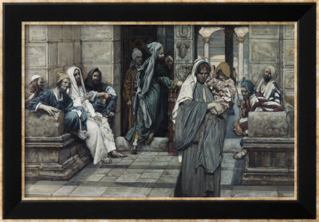
Widow’s Mite: She Gave More!
Notes:
⁴¹Jesus sat down opposite the place where the offerings were put and watched the crowd putting their money into the temple treasury. Many rich people threw in large amounts. ⁴²But a poor widow came and put in two very small copper coins,^{[j]}worth only a fraction of a penny.^{[k]} ⁴³Calling his disciples to him, Jesus said, "I tell you the truth, this poor widow has put more into the treasury than all the others. ⁴⁴They all gave out of their wealth; but she, out of her poverty, put in everything—all she had to live on.“
She gave more! Do you believe that? Was he joking?
Jesus’s value is not ours. He would have put up a plaque honoring the small poor donor, not the rich donor who gives large sums.
What made it more?
Percentage
Nothing held back
Cost her something
she gets nothing – no praise, glory, plaques

Slide 43
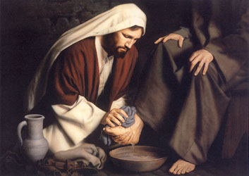
James 1:9-11
The brother in lowly circumstances should take pride in his high standing, and the rich one in his lowliness, for he will pass away "like the flower of the field.”
Notes:
So how should we behave if we have much?
“take pride in our lowliness”
- our riches will pass away
- serve the others
- don’t be proud of your riches
- to whom do we give credit”
- ourselves, not God
- are you the richest in love? In service? In patience? In generosity? In anonymity?
2Cor. 4:18: So we fix our eyes not on what is seen, but on what is unseen. For what is seen is temporary, but what is unseen is eternal.

Slide 44

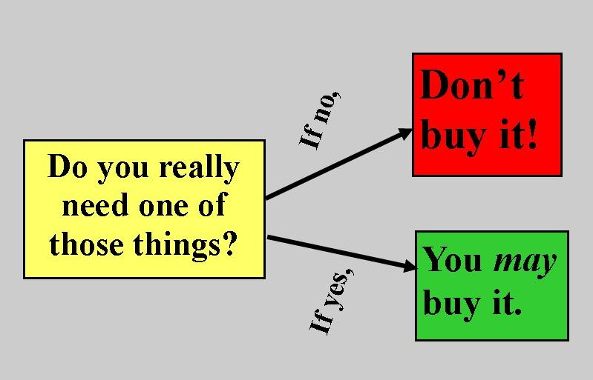

Advice: Get Perspective!
Notes:
I hope I have convinced you, if you need convincing, that consumerism is a problem, not just for others, but for us all. The Popes agree, and the Bible gives lots of evidence to this pattern:
Material riches, gift form God, are taken by us, treated like the most important thing, and we neglect God, making goods out idols.
What do we do now? Should we just not have things? Should we starve? No. Should we act as if this is not a weakness? No
We need perspective. Who do we turn to? To wise people, of course, but primarily to the source of all wisdom, who made all goods, who made us, who knows our weakness, and who can teach us where goods fit into our lives.

Slide 45
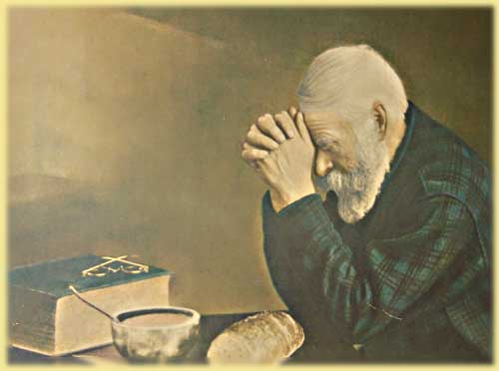
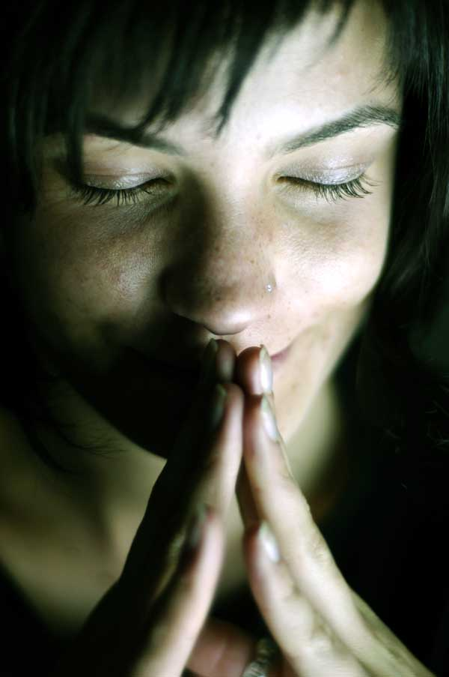
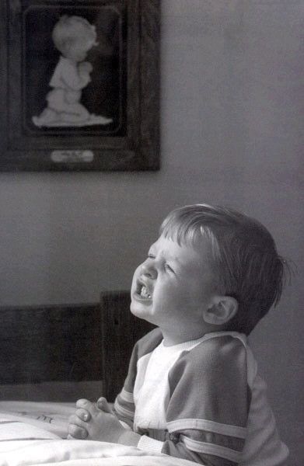
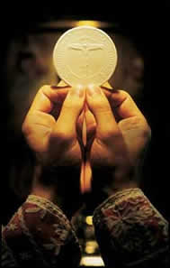
Pray!
Fall broke
Friendship with
God
Befriend Him!
Get His
Perspective
Notes:
We can know Christ!
Only if we spend time with him
Christ calls us friend! Does this mean buddy? No, but friend nonetheless
big brother? What did his friends call him?
- “master”
- “teacher”
If you are a friend with someone, you want to spend time with him
- learn about them
- tell them what challenges you are facing – “how should I make this decision?
What should my attitude toward riches be?
- find out what they think, ask them questions
- listen to what they have to say
Eucharist – the greatest prayer
- establishes our friendship, feeds us
Blessed sacrament
- Christ is present to us everywhere, but here it is more
– Christ as present to us as he was to his disciples!

Slide 46

Friendship with Christ
Read the Bible!
“Ignorance of Scripture is Ignorance of Christ”
- St. Jerome
Notes:
If you are in love with someone, want to know as much about them as possible
What does Jesus think, what did he do when he was with us?
Spend time with Christ in Scripture

Slide 47
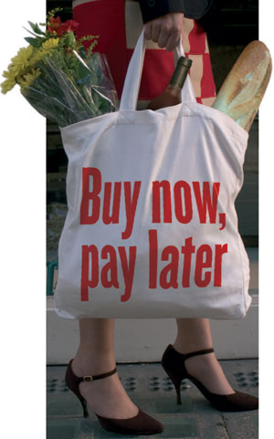
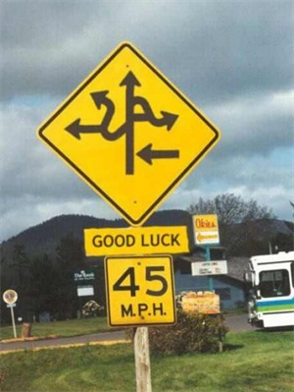
Friendship with Christ
Don’t Fool
Yourself
You Are
Very Easy
to Fool!
Notes:
We need to make a habit of spending time with Christ in Scripture, in prayer, and in the mass.
Why? Because we are fallen!
Richard Feynman quote about scientific method
- Good advice about science is good advice about life in general.
- we are swimming in a culture of consumption
- easy to fool ourselves

Slide 48
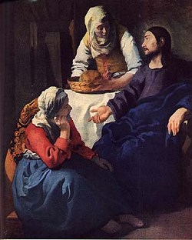
Friendship with Christ
No Instant Answers
Don’t Seek Rules
Seek Guidance
Notes:
Importance of spending time with Jesus.
What do we seek?
- not rules
- not to go against rules
- for example, I think tithing is a great rule of thumb
- but don’t think rules will are enough
- don’t let us off the hook
- can be an excuse for giving less
- (remember the rich young man)
- we need the mind of Christ, his perspective

Slide 49
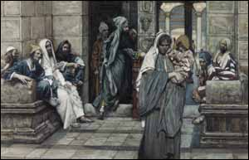

Be Generous
Live Dangerously!
10 %?
Notes:
What practical advice comes from the Church, the saints, the experience of living in this world?
Be generous! How generous? Go beyond what we are comfortable with! Remember the poor widow!
Does giving 10% of your income to Church and charity seem outrageous, irresponsible? A good goal, then. Am I telling you to give that much? No. But maybe God is! Perhaps we need to put ourselves in a position to do that.
Are you giving 10%? Maybe 11%, 15%?
For those of you who are younger, perhaps God is calling you to evaluate your attitude toward kids. I can attest, that Dad’s see $ signs when thinking about another child. But talk about treasure in heaven. A child is an eternal soul, and a blessing to the rest of the family. My favorite quote from a father of a large family is : “what else are we going to spend our money on?”

Slide 50

Be Moderate
Live One Step Down from what You Can Afford
  Cars
  Clothing
  Housing
  Food
  Play
Notes:
I taught a course on Christianity and economics a year ago, and he offered what I thought was great advice to the students:
Live one step down from what you can afford.
Ferrari? lexus.
4000 square feet? How about 3500?

Slide 51
Think on the Four Last Things
Notes:
What are the four last things? If you don’t know, memorize them. They are everyone’s last things.

Slide 52
Think on the Four Last Things
Death
Judgment
Heaven
Hell
Notes:
We are not supposed to think on these things – they are supposed to be downers in our Hollywood culture.
We are supposed to act as if we are not going to die.
We are – and we are going to be judged, and go to either heaven or hell.
We need this perspective
We come life with only a body
When we leave this life, we will leave even our body behind. Reunited with it
at the last judgment.

Slide 53
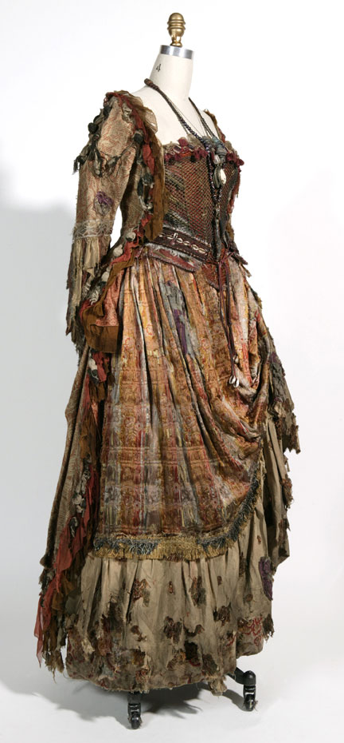

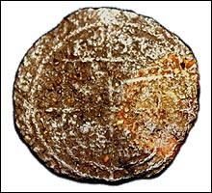
Where is Your Treasure? (Mt. 6:19-21)
But store up treasures in heaven, where neither moth nor decay destroys, nor thieves break in and steal. For where your treasure is, there will be your heart also.
Notes:
"Do not store up for yourselves treasures on earth, where moth and decay destroy, and thieves break in and steal. But store up treasures in heaven, where neither moth nor decay destroys, nor thieves break in and steal. For where your treasure is, there also will your heart be.
Matthew 6: 19-21

Slide 54
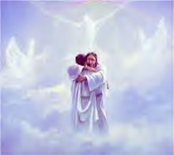
Treasure in Heaven
Notes:
²⁴"No one can serve two masters. Either he will hate the one and love the other, or he will be devoted to the one and despise the other. You cannot serve both God and Money.
²⁵"Therefore I tell you, do not worry about your life, what you will eat or drink; or about your body, what you will wear. Is not life more important than food, and the body more important than clothes.
³¹So do not worry, saying, 'What shall we eat?' or 'What shall we drink?' or 'What shall we wear?' ³²For the pagans run after all these things, and your heavenly Father knows that you need them. ³³But seek first his kingdom and his righteousness, and all these things will be given to you as well. ³⁴Therefore do not worry about tomorrow, for tomorrow will worry about itself. Each day has enough trouble of its own.

Slide 55

Prayer of St. Ignatius
Lord Jesus Christ, take all my freedom, my memory, my understanding, and my will.
All that I have and cherish You have given me;
I surrender it all to be guided by your will.
Your grace and your love are wealth enough for me.
Give me these, Lord Jesus, and I ask for nothing more.
Notes:
Final prayer. I find this very helpful in keeping my perspective every day.
Ignatius
Let’s pray it together

